Slide 1

Lecture 14 Indexing and Hashing
(Chapters 14)
Prof. Jihong Guan
Email: jhguan@tongji.edu.cn
Department of Computer Science and Technology
Tongji University

Slide 2
Outline of the Course
Part 0: Overview
Ch1: Introduction
Part 1 Relational Databases
Ch2: Relational model (data model, relational algebra)
Ch3&4: SQL(Structured Query Language)
Ch5: Advanced SQL
Part 2 Database Design
Ch6: Database design based on E-R model
Ch7: Relational database design
Part 3 Application Design & Development
Ch8: Complex data types
Ch9: Application development
Part 4 Big data analytics
Ch10: Big data
Ch11: Data analytics
☞ Part 5 Data Storage & Indexing
Ch12: Physical storage system
Ch13: Data storage structure
Ch14: Indexing
Part 6 Query Processing & Optimization
Ch15: Query processing
Ch16: Query optimization
Part 7 Transaction Management
Ch17: Transactions
Ch18: Concurrency control
Ch19: Recovery system
Part 8 Parallel & Distributed Database
Ch20: Database system architecture
Ch21-23: Parallel & distributed storage, query processing & transaction processing
Part 9
DB Platform:OceanBase, MongoDB, Neo4J

Slide 3
Outline
☞ Basic Concepts
Ordered Indexing
B⁺-tree & B-tree Indices
Static & Dynamic Hashing
Ordered Indexing vs. Hashing
Index Definition in SQL
Multiple-key Access

Slide 4
Index vs. Data (索引块与数据块)
索引可提高检索效率，其结构(二叉树、B⁺树等)占用空间小，所以访问速度快
如果表中的一条记录在磁盘上占用 1000字节，对其中10字节的一个字段建立索引，那么该记录对应的索引项的大小只有10字节。如SQL Server的最小空间分配单元是“页Page”，一个页在磁盘上占用8K空间，可以存储上述记录8条，但可以存储索引800条
从一个有8000条记录表中检索符合某个条件的记录，如没有索引，可能需要遍历8000条×1000字节/8K字节=1000个页面才能找到结果。如果在检索字段上有上述索引，则可以在8000条×10字节/8K字节=10个页面中检索到满足条件的索引块，然后根据索引块上的指针逐一找到结果数据块，这样I/O访问量要少很多

Slide 5
Basic Concepts
Indexing mechanisms
Speed up the access to desired data
Index files are typically much smaller than the original file
Search Key(搜索码/关键字)
The set of attributes used to look up records in a file/table
An index file consists of records (called index entries, 索引项) of the form (search-key, pointer)
Two kinds of indices
Ordered index (顺序索引): search keys are stored in sorted order
Hash index (散列索引): search keys are distributed uniformly across “buckets” using a “hash function”
search-key
pointer

Slide 6
Index Evaluation Metrics
Access types supported efficiently
Equal-query(等值查询)、Range-query(范围查询)
能有效支持的访问类型，如找到具有特定属性值的所有记录，找到其属性值在某个特定范围所有记录(Equal Query、Range Query)
Access time:访问时间
Insertion time:插入一个新数据项时间，包括: 找到插入位置时间 + 更新索引结构时间
Deletion time:删除一个数据项时间，包括: 找到待删除项时间 + 更新索引结构时间
Space overhead:空间开销，一个索引结构占用的额外存储空间

Slide 7
Outline
Basic Concepts
☞ Ordered Indexing
B⁺-tree & B-tree Indices
Static & Dynamic Hashing
Ordered Indexing vs. Hashing
Index Definition in SQL
Multiple-key Access

Slide 8
Ordered Indexing-顺序索引
Ordered index
Index entries are sorted on the search key value
Primary index and secondary index
Primary index (主索引), clustering index 聚集索引
包含记录的文件按某个搜索码指定的顺序排序，该搜索码对应的索引称为 clustering index
Secondary index (辅助索引), no-clustering index (非聚集索引)
An index whose search key specifies an order different from the sequential order of the file
Index-sequential file (索引顺序文件)
Ordered sequential file with a primary index
索引顺序文件是顺序文件的扩展，其中各记录本身在介质上也是顺序排列的，包含了直接处理和修改记录的能力。索引顺序文件能像顺序文件一样进行快速顺序处理，既允许按物理存放次序（记录出现的次序），也允许按逻辑顺序（由记录主关键字决定的次序）进行处理。索引顺序文件通常用树结构来组织索引。静态索引结构ISAM和动态索引结构VSAM
Notes:
索引顺序文件是顺序文件的扩展，其中各记录本身在介质上也是顺序排列的，它包含了直接处理和修改记录的能力。索引顺序文件能像顺序文件一样进行快速顺序处理，既允许按物理存放次序（记录出现的次序），也允许按逻辑顺序（由记录主关键字决定的次序）进行处理。索引顺序文件通常用树结构来组织索引。索引结构形成后，根据在系统运行时索引结构是否变化，又分为静态索引结构和动态索引结构。前者以 ISAM文件为代表，后者以VSAM为代表。ISAM文件和VSAM文件最常用的索引顺序文件。
ISAM为Indexed Sequential Access Methed（索引顺序存取方法）的缩写，它是一种专为磁盘存取文件设计的文件组织方式，采用静态索引结构。由于磁盘是以盘组、柱面和磁道三级地址存取的设备，则可对磁盘上的数据文件建立盘组、柱面和磁道多级索引。
ISAM文件由多级主索引、柱面索引、磁道索引和主文件组成。文件的记录在同一盘组上存放时，应先集中放在一个柱面上，然后再顺序存放在相邻的柱面上。对同一柱面，则应按盘面的次序顺序存放。
VSAM是Virtual Storage AccessMethod（虚拟存储存取方法）的缩写，它也是一种索引顺序文件的组织方式，采用B⁺树作为动态索引结构。
VSAM文件的结构由三部分组成：索引集，顺序集和数据集。
顺序集和索引集一起构成一棵B+树，作为文件的索引部分。顺序集中存放的每个控制区间的索引项由两部分信息组成：该控制区间中的最大关键字和指向控制区间的指针。若干相邻的控制区间的索引项，形成顺序集中的一个结点。结点之间用指针相链接，而每个结点又在其上一层的结点中建有索引，且逐层向上建立索引，所有的索引项都由最大关键字和指针两部分信息组成。这些高层的索引项形成B+树的非终端结点。
VSAM文件既可在顺序集中进行顺序存取，又可从最高层的索引（B+树的根结点）出发，进行按关键字的随机存取。顺序集中一个结点连同其对应的所有控制区间形成一个整体，称做控制区域（ControlRange）。它相当于ISAM文件中的一个柱面，而控制区间相当于一个磁道。
在VSAM文件中，记录可以是不定长的。因而在控制区间中，除了存放记录本身之外，还有每个记录的控制信息（如记录的长度等）和整个区间的控制信息（如区间中存放的记录数等）。

Slide 9
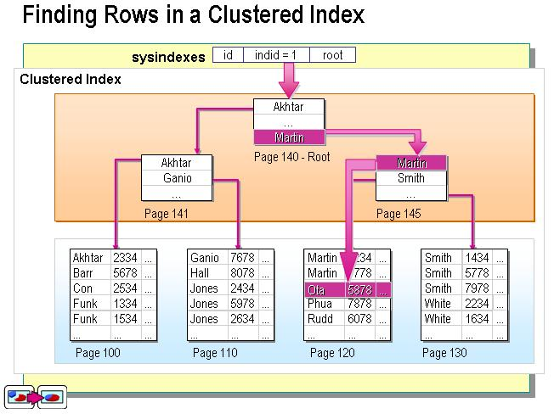
Primary Index：Clustering Index
聚集索引的叶节点就是数据节点，索引顺序就是数据物理存储顺序。一个表最多只能有一个聚集索引

Slide 10
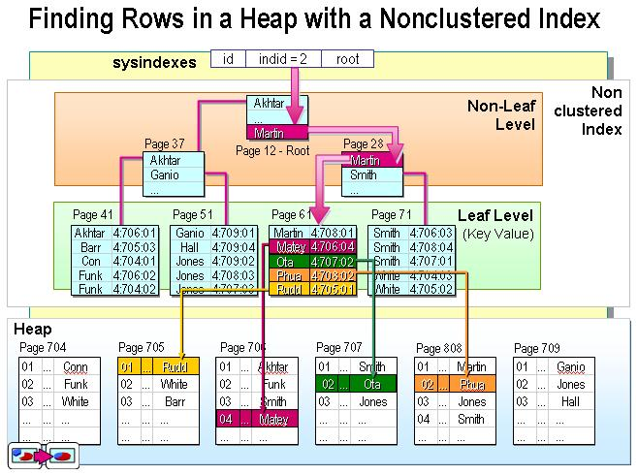
Secondary Index：Non-clustering Index
非聚集索引的叶节点仍然是索引节点，有一个指针指向对应的数据块。非聚集索引顺序与数据物理排列顺序无关
Page 708

Slide 11
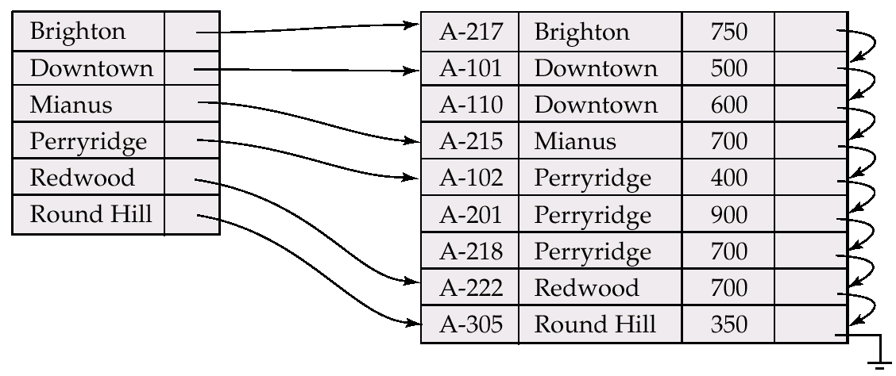
Dense Index
Dense index (稠密索引)
Index record appears for every search-key value in the file

Slide 12
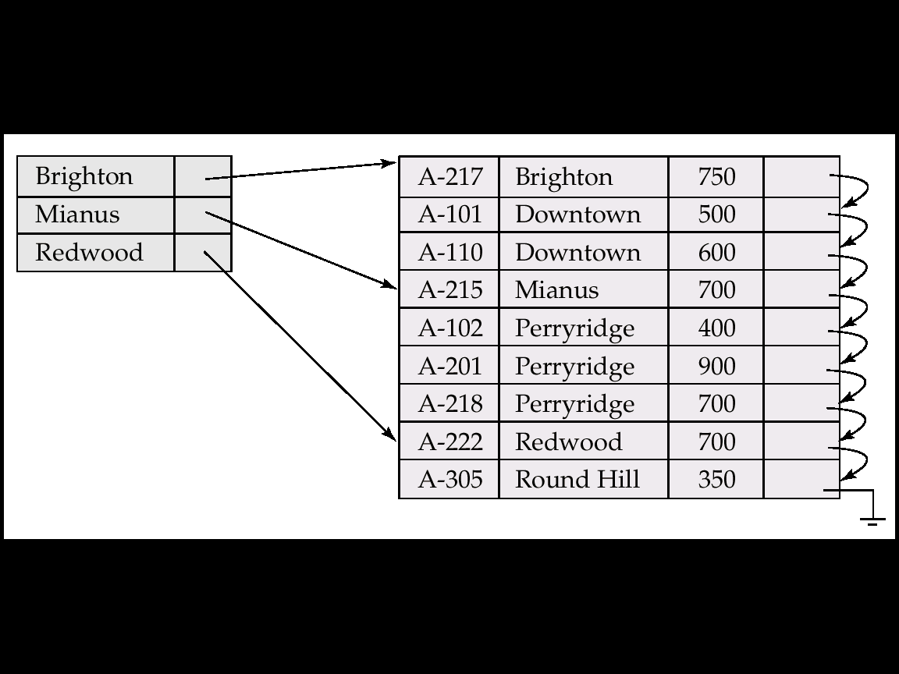
Sparse Index
Sparse Index (稀疏索引)
Contain index records for only some search-key values when records are sequentially ordered on search-key (why?)

Slide 13
Multilevel Index (多级索引)
If primary index does not fit in memory, data access becomes expensive
To reduce the number of disk accesses to index records, treat primary index as a sequential file and construct a sparse index on it
outer index – a sparse index of primary index
inner index – the primary index file
If even outer index is too large to fit in main memory, yet another level of index can be created, and so on

Slide 14
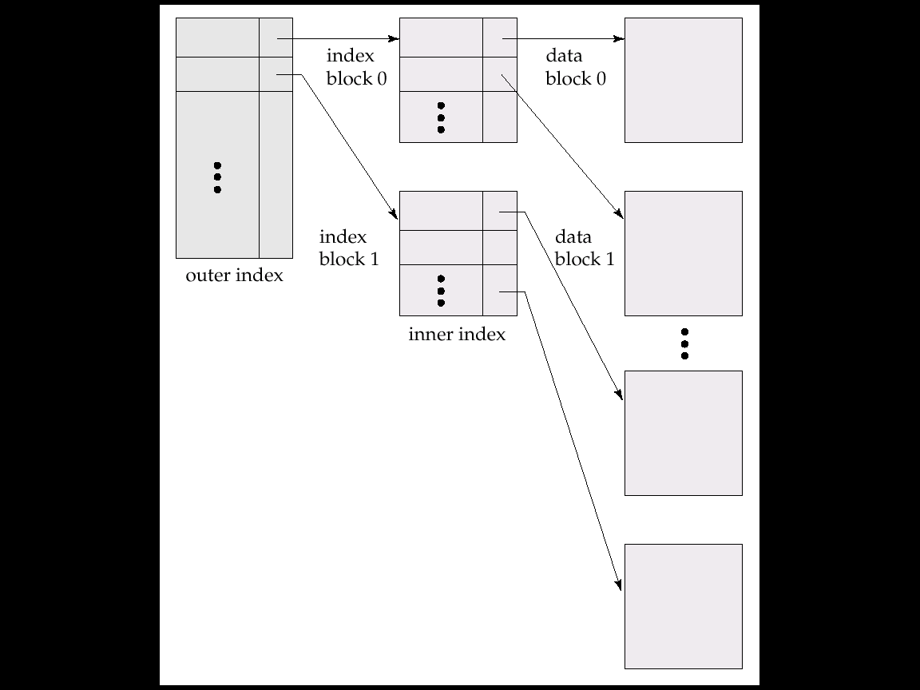
Multilevel Index (Cont.)

Slide 15
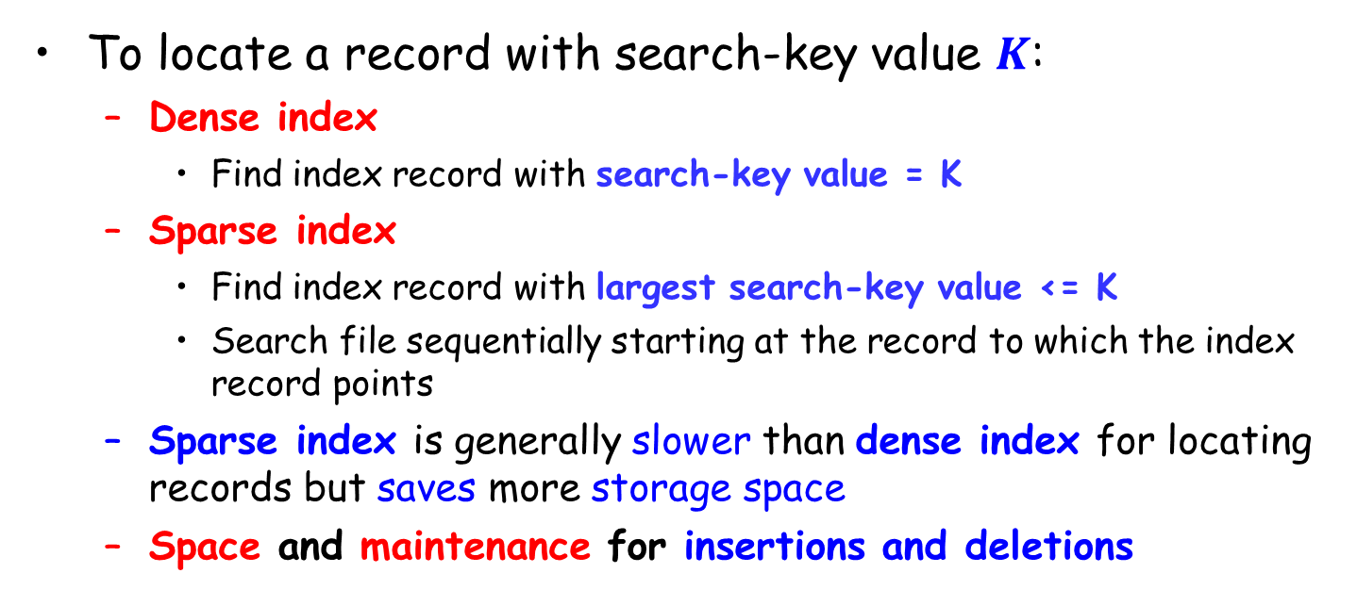
Dense vs. Sparse Index
To locate a record with search-key value $K$:
Dense index
Find index record with search-key value = K
Sparse index
Find index record with largest search-key value <= K
Search file sequentially starting at the record to which the index record points
Sparse index is generally slower than dense index for locating records but saves more storage space
Space and maintenance for insertions and deletions

Slide 16
Index Update: Deletion
Single-level index deletion
Dense indices – deletion of search-key in index is similar to file record deletion

Slide 17
Index Update: Deletion
Single-level index deletion
Sparse indices
if an entry for the search key exists in the index, it is deleted by replacing the entry in the index with the next search-key value in the file
if the next search-key value already has an index entry, the entry is deleted instead of being replaced

Slide 18
Index Update: Insertion
Single-level index insertion
Perform a lookup using the search-key value
Dense indices – if the search-key value does not appear in the index, insert it
Sparse indices – if index stores an entry for each block of the file, no change needs to be made to the index unless a new block is created. In this case, the first search-key value appearing in the new block is inserted into the index
Multilevel insertion/deletion
Extensions of the single-level algorithms

Slide 19
Dense vs. Sparse Index
Space and maintenance for insertions and deletions
Sparse index needs less space and less maintenance overhead for insertions and deletions
Good tradeoff: sparse index with an index entry for every block in file, corresponding to the least search-key value in the block

Slide 20
Secondary Indices
To find all the records with values in a certain range
Example 1: In the account relation stored sequentially by account number, we may want to find all accounts in a particular branch
Example 2: to find all accounts with a specified balance or range of balances
Secondary index
Build a secondary index with an index record for each search-key value
Index record points to a bucket that contains pointers to all the actual records with that particular search-key value

Slide 21
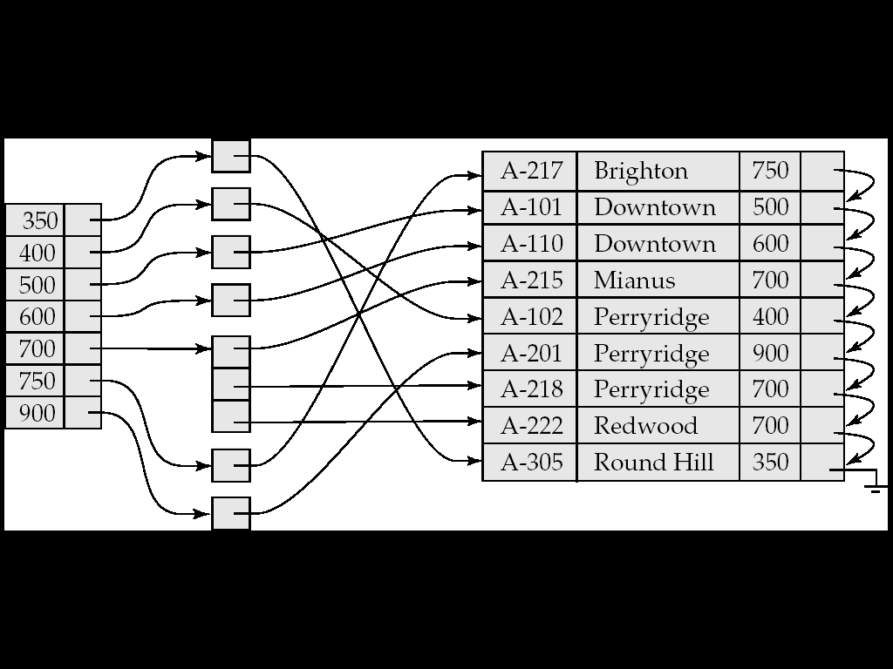
Secondary Index on Balance Field of Account
bucket

Slide 22
Primary and Secondary Indices
Secondary indices have to be dense (why?)
When a file is modified, every index on the file must be updated. Updating indices imposes overhead on database modification
Sequential scan using primary index is efficient, but a sequential scan using a secondary index is expensive
each record access may fetch a new block from disk

Slide 23
Outline
Basic Concepts
Ordered Indexing
☞ B⁺-tree & B-tree Indices
Static & Dynamic Hashing
Ordered Indexing vs. Hashing
Index Definition in SQL
Multiple-key Access

Slide 24
B⁺-Tree Index Files
B⁺-tree is an alternative to indexed-sequential file
Disadvantage of indexed-sequential file
Performance degrades as file grows, since many overflow blocks (溢出块) get created. Periodic reorganization of entire file is required
B⁺-tree index file
Advantage: automatically reorganizes itself with small and local changes, in the face of insertions and deletions. Reorganization of entire file is not required to maintain performance
Disadvantage: extra insertion and deletion overhead, space overhead
B⁺-tree is used widely since its advantages outweight the disadvantages

Slide 25
Example of B⁺-Tree

Slide 26
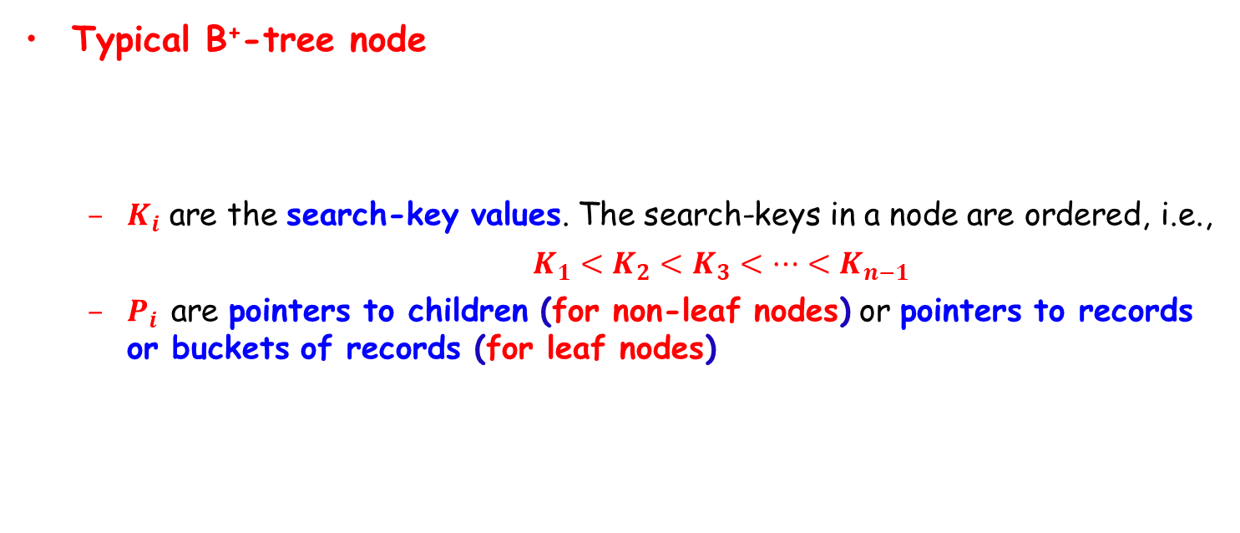
B⁺-Tree Index Files (Cont.)
Typical B⁺-tree node
$K_{i}$ are the search-key values. The search-keys in a node are ordered, i.e.,
$K_{1}<K_{2}<K_{3}<⋯<K_{n−1}$
$P_{i}$ are pointers to children (for non-leaf nodes) or pointers to records or buckets of records (for leaf nodes)

Slide 27
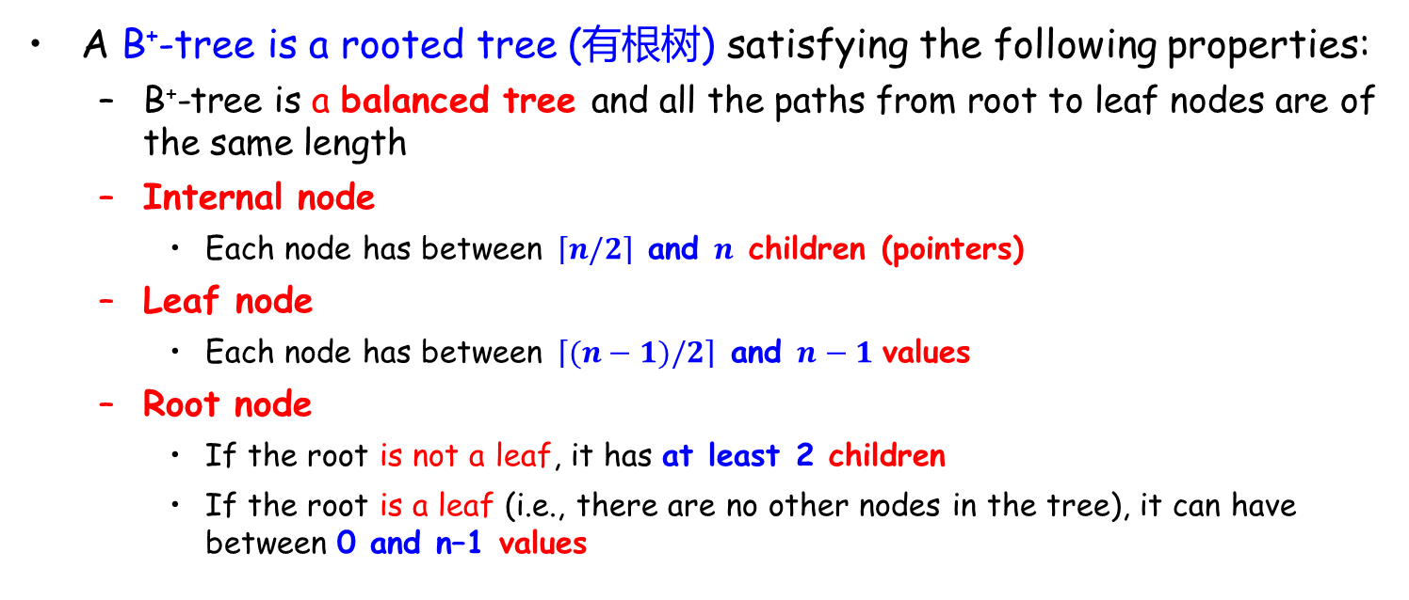
B⁺-Tree Index Files (Cont.)
A B⁺-tree is a rooted tree (有根树) satisfying the following properties:
B⁺-tree is a balanced tree and all the paths from root to leaf nodes are of the same length
Internal node
Each node has between $\left\lceil n/2\right\rceil$ and $n$ children (pointers)
Leaf node
Each node has between $\left\lceil (n−1)/2\right\rceil$ and $n−1$ values
Root node
If the root is not a leaf, it has at least 2 children
If the root is a leaf (i.e., there are no other nodes in the tree), it can have between 0 and n–1 values

Slide 28
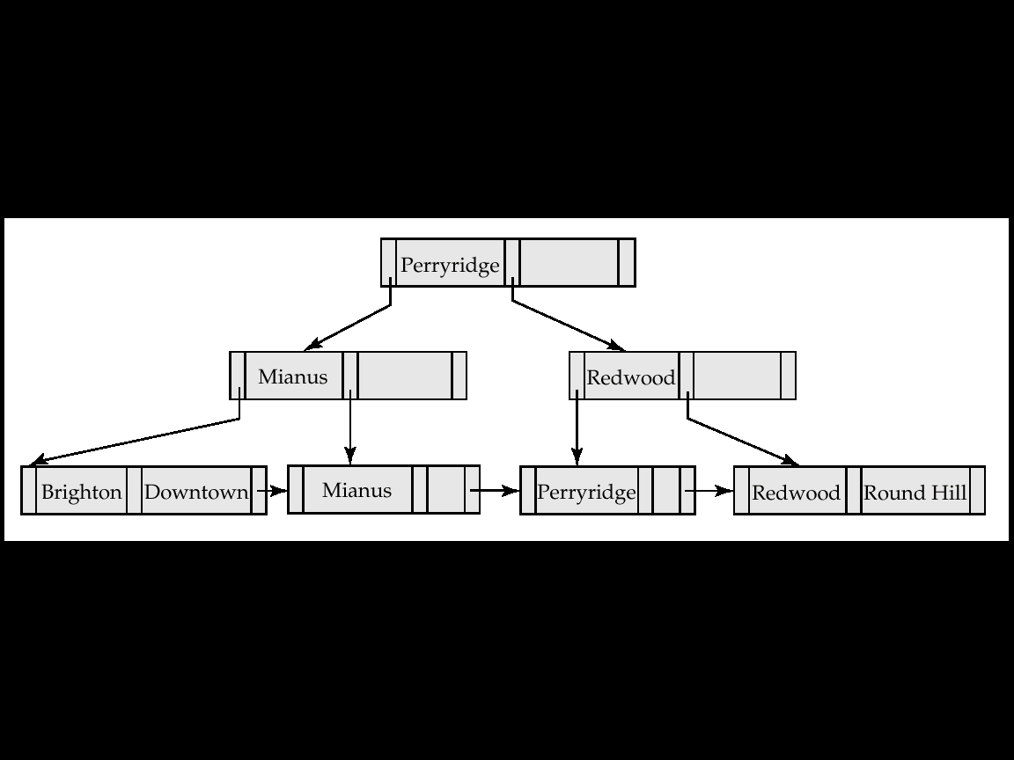
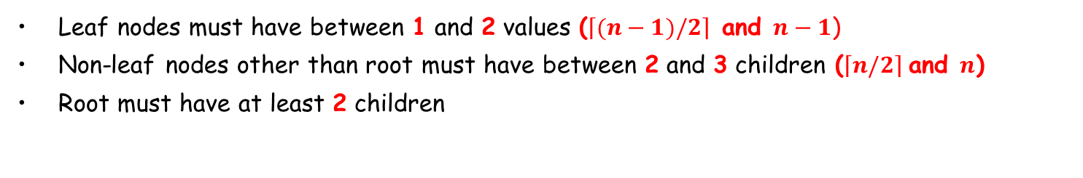
Example of a B⁺-tree
B⁺-tree for account file (n = 3)
Leaf nodes must have between 1 and 2 values ($\left\lceil (n−1)/2\right\rceil$ and $n−1$)
Non-leaf nodes other than root must have between 2 and 3 children ($\left\lceil n/2\right\rceil$and $n$)
Root must have at least 2 children

Slide 29


Leaf Node in B⁺-Tree
Properties of a leaf node
Pointer $P_{i}$ either points to a file record with search-key value $K_{i}$, or to a bucket of pointers to file records, each record having search-key value $K_{i}$. Only need bucket structure if the search-key does not form a primary key (why?)
$P_{n}$ points to next leaf node in search-key order
instructor file
$n$=4

Slide 30
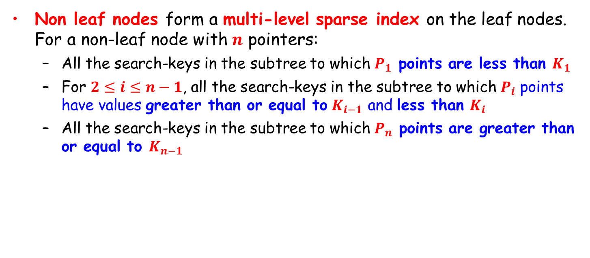
Non-Leaf Nodes in B⁺-Tree
Non leaf nodes form a multi-level sparse index on the leaf nodes. For a non-leaf node with $n$ pointers:
All the search-keys in the subtree to which $P_{1}$ points are less than $K_{1}$
For $2≤i≤n−1$, all the search-keys in the subtree to which $P_{i}$ points have values greater than or equal to $K_{i−1}$ and less than $K_{i}$
All the search-keys in the subtree to which $P_{n}$ points are greater than or equal to $K_{n−1}$

Slide 31
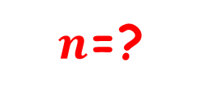
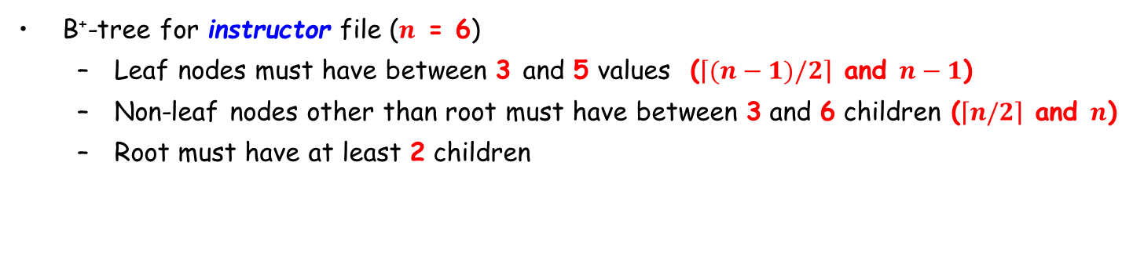
Example of B⁺-tree
$n$=?
B⁺-tree for instructor file ($n$ = 6)
Leaf nodes must have between 3 and 5 values ($\left\lceil (n−1)/2\right\rceil$ and $n−1$)
Non-leaf nodes other than root must have between 3 and 6 children ($\left\lceil n/2\right\rceil$ and $n$)
Root must have at least 2 children

Slide 32
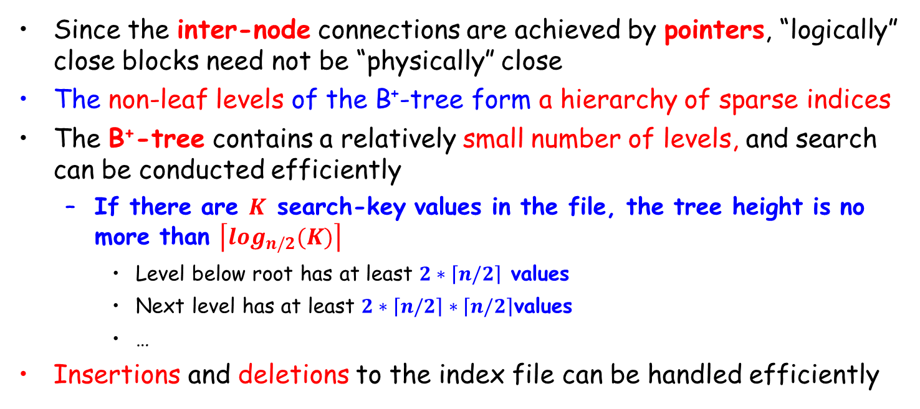
Observations about B⁺-tree
Since the inter-node connections are achieved by pointers, “logically” close blocks need not be “physically” close
The non-leaf levels of the B⁺-tree form a hierarchy of sparse indices
The B⁺-tree contains a relatively small number of levels, and search can be conducted efficiently
If there are $K$ search-key values in the file, the tree height is no more than $\left\lceil \log_{n/2}(K)\right\rceil$
Level below root has at least $2∗\left\lceil n/2\right\rceil$ values
Next level has at least $2∗\left\lceil n/2\right\rceil ∗\left\lceil n/2\right\rceil$values
…
Insertions and deletions to the index file can be handled efficiently

Slide 33
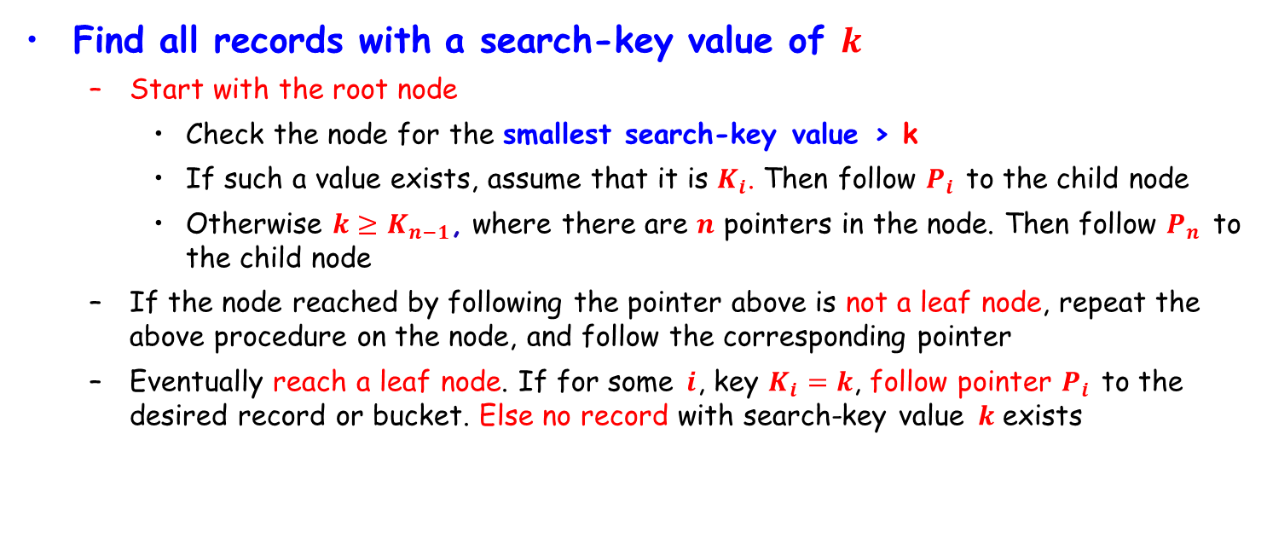
Queries on B⁺-Trees
Find all records with a search-key value of $k$
Start with the root node
Check the node for the smallest search-key value > k
If such a value exists, assume that it is $K_{i}$. Then follow $P_{i}$ to the child node
Otherwise $k≥K_{n−1}$, where there are $n$ pointers in the node. Then follow $P_{n}$ to the child node
If the node reached by following the pointer above is not a leaf node, repeat the above procedure on the node, and follow the corresponding pointer
Eventually reach a leaf node. If for some $i$, key $K_{i}=k$, follow pointer $P_{i}$ to the desired record or bucket. Else no record with search-key value $k$ exists

Slide 34
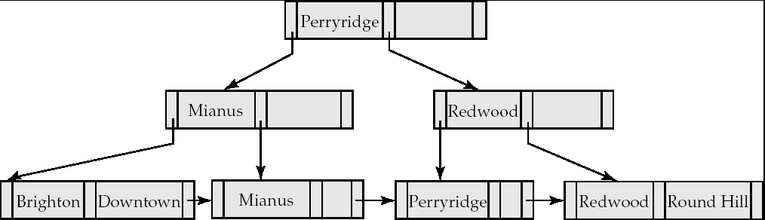
Example: Queries on B⁺-Tree
Search begins at root, and key comparisons direct it to a leaf
Search for Perryridge

Slide 35
Example: Queries on B⁺-Tree
Search begins at root, and key comparisons direct it to a leaf
Search for 5*, 15*, all data entries >= 24*
Root
13
17
24
30
n = 5
2*
3*
5*
7*
14*
16*
19*
20*
22*
24*
27*
29*
33*
34*
38*
39*

Slide 36
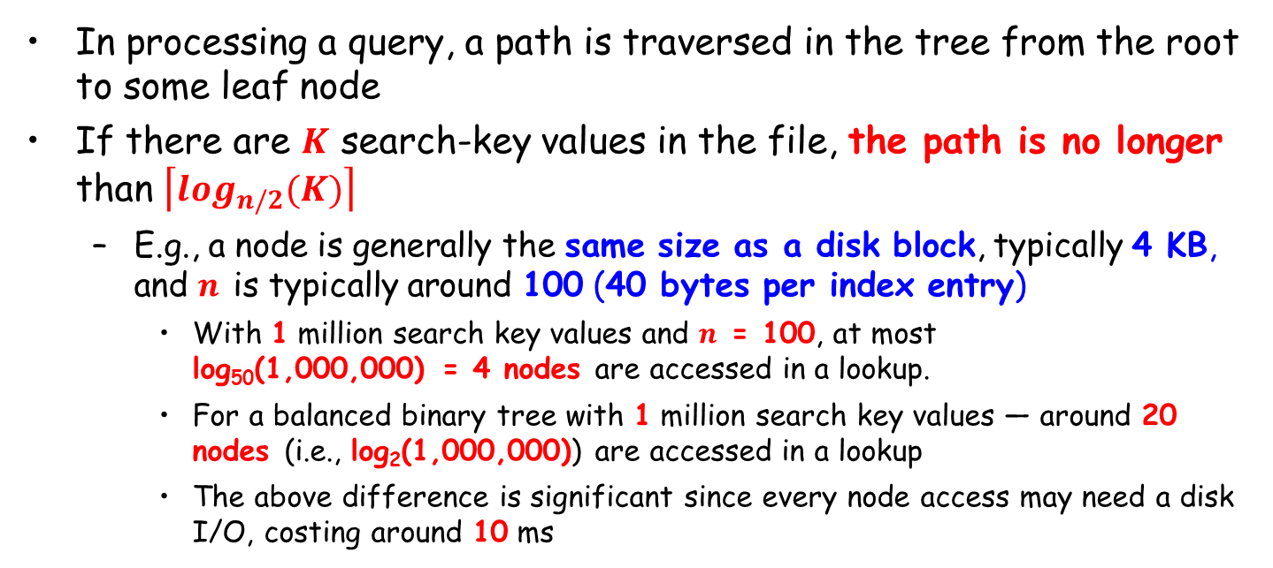
Queries on B⁺-Trees (Cont.)
In processing a query, a path is traversed in the tree from the root to some leaf node
If there are $K$ search-key values in the file, the path is no longer than $\left\lceil \log_{n/2}(K)\right\rceil$
E.g., a node is generally the same size as a disk block, typically 4 KB, and $n$ is typically around 100 (40 bytes per index entry)
With 1 million search key values and $n$ = 100, at most log₅₀(1,000,000) = 4 nodes are accessed in a lookup.
For a balanced binary tree with 1 million search key values — around 20 nodes (i.e., log₂(1,000,000)) are accessed in a lookup
The above difference is significant since every node access may need a disk I/O, costing around 10 ms

Slide 37
Insertion in B⁺-Tree
Find the leaf node in which the search-key value would appear
If the search-key value is already in the leaf node
record is added to file
if necessary, a pointer is inserted into the bucket
If the search-key value is not in certain node, add the record to the main file and create a bucket if necessary. Then:
If there is room in the leaf node, insert (key-value, pointer) pair in the leaf node
Otherwise, split the node along with the new (key-value, pointer) entry

Slide 38
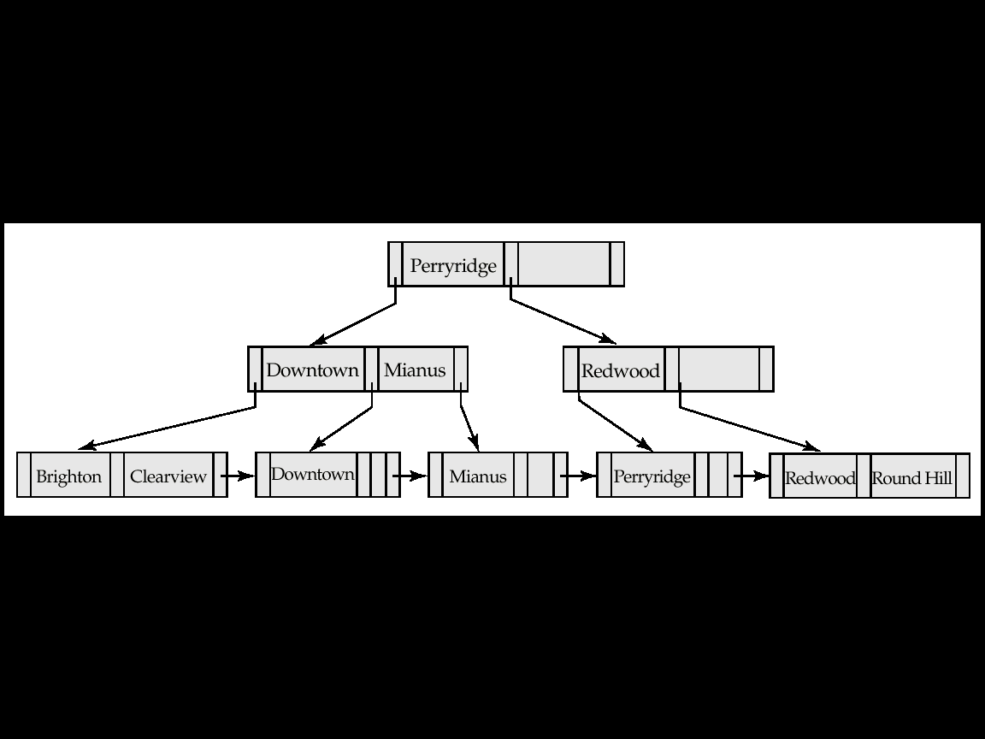
Insertion in B⁺-Tree (Cont.)
n = 3
B⁺-Tree before and after the insertion of “Clearview”

Slide 39
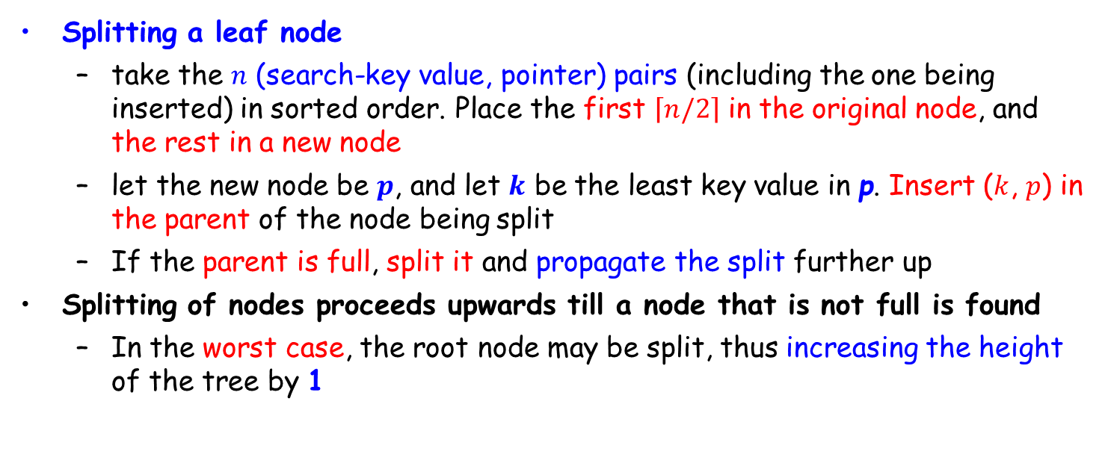
Insertion in B⁺-Tree (Cont.)
Splitting a leaf node
take the $n$ (search-key value, pointer) pairs (including the one being inserted) in sorted order. Place the first $\left\lceil n/2\right\rceil$ in the original node, and the rest in a new node
let the new node be $p$, and let $k$ be the least key value in p. Insert ($k$, $p$) in the parent of the node being split
If the parent is full, split it and propagate the split further up
Splitting of nodes proceeds upwards till a node that is not full is found
In the worst case, the root node may be split, thus increasing the height of the tree by 1

Slide 40
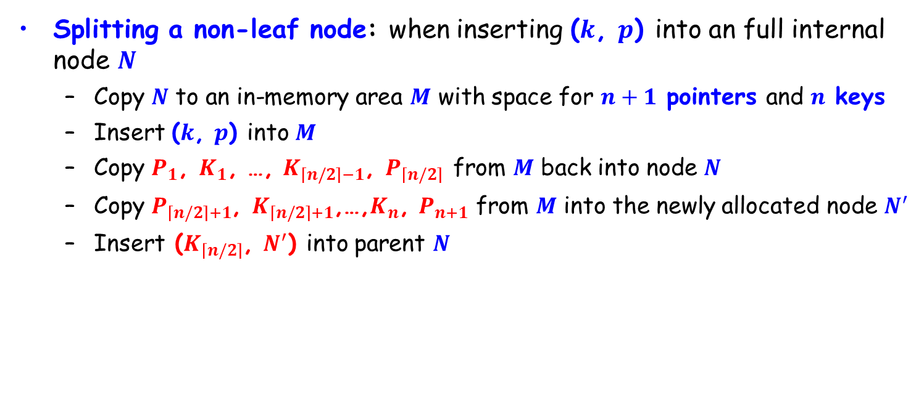
Insertion in B+-Tree (Cont.)
Splitting a non-leaf node: when inserting ($k$, $p$) into an full internal node $N$
Copy $N$ to an in-memory area $M$ with space for $n+1$ pointers and $n$ keys
Insert ($k$, $p$) into $M$
Copy $P_{1}$, $K_{1}$, …, $K_{\left\lceil n/2\right\rceil −1}$, $P_{\left\lceil n/2\right\rceil }$ from $M$ back into node $N$
Copy $P_{\left\lceil n/2\right\rceil +1}$, $K_{\left\lceil n/2\right\rceil +1}$,…,$K_{n}$, $P_{n+1}$ from $M$ into the newly allocated node $N^{′}$
Insert ($K_{\left\lceil n/2\right\rceil }$, $N^{′}$) into parent $N$

Slide 41
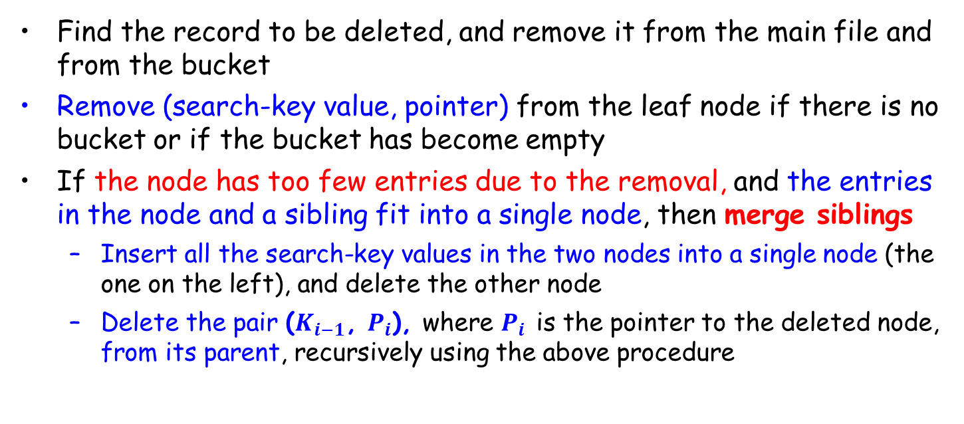
Deletion in B⁺-Tree
Find the record to be deleted, and remove it from the main file and from the bucket
Remove (search-key value, pointer) from the leaf node if there is no bucket or if the bucket has become empty
If the node has too few entries due to the removal, and the entries in the node and a sibling fit into a single node, then merge siblings
Insert all the search-key values in the two nodes into a single node (the one on the left), and delete the other node
Delete the pair ($K_{i−1}$, $P_{i}$), where $P_{i}$ is the pointer to the deleted node, from its parent, recursively using the above procedure

Slide 42
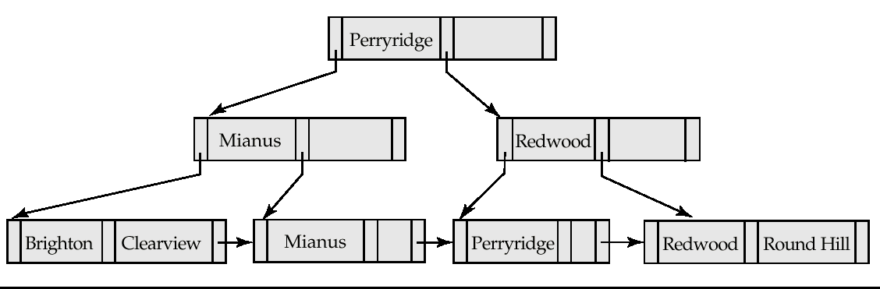

Examples of B⁺-Tree Deletion
$n$ = 3
Before and after deleting “Downtown”
Deleting “Downtown” causes merging of under-full leaves
The removal of the leaf node containing “Downtown” did not result in its parent having too little pointers. So the cascaded deletions stopped with the deleted leaf node’s parent

Slide 43
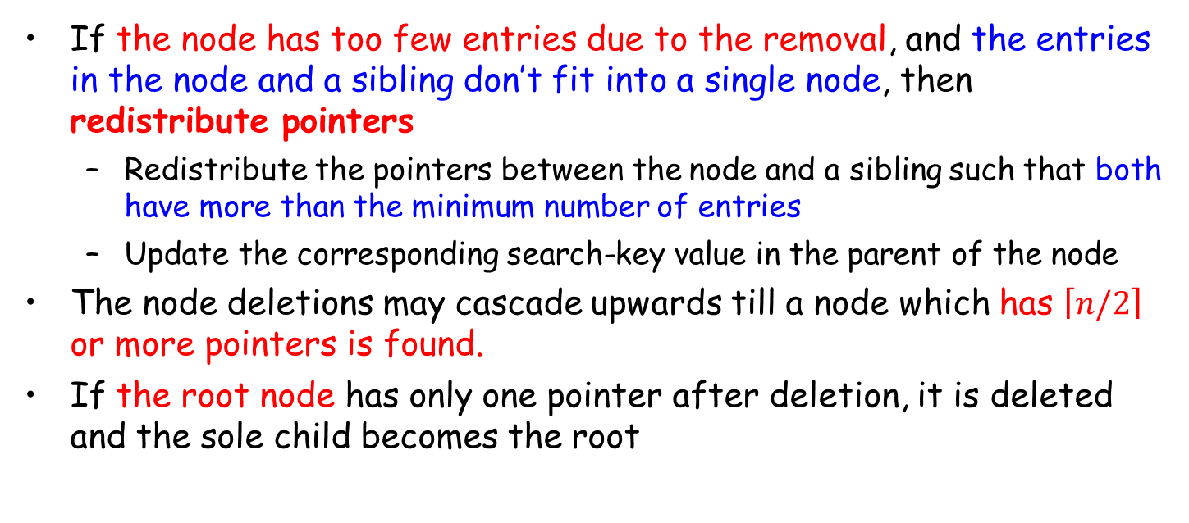
Deletion in B⁺-Tree (Cont.)
If the node has too few entries due to the removal, and the entries in the node and a sibling don’t fit into a single node, then redistribute pointers
Redistribute the pointers between the node and a sibling such that both have more than the minimum number of entries
Update the corresponding search-key value in the parent of the node
The node deletions may cascade upwards till a node which has $\left\lceil n/2\right\rceil$ or more pointers is found.
If the root node has only one pointer after deletion, it is deleted and the sole child becomes the root

Slide 44
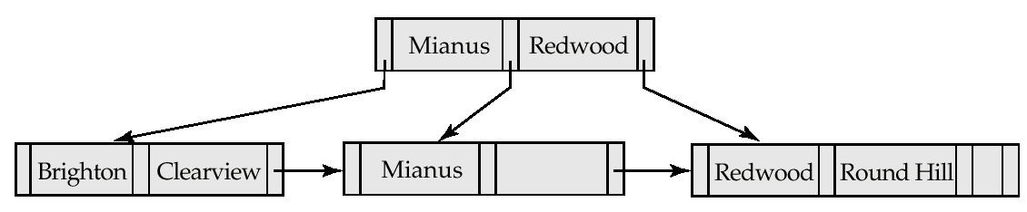
Examples of B⁺-Tree Deletion (Cont.)
n = 3
Deletion of “Perryridge”
Node with “Perryridge” becomes underfull (actually empty, in this special case) and merged with its sibling
As a result “Perryridge” node’s parent became underfull, and was merged with its sibling (and an entry was deleted from their parent)
Root node then had only one child, and was deleted and its child became the new root node

Slide 45
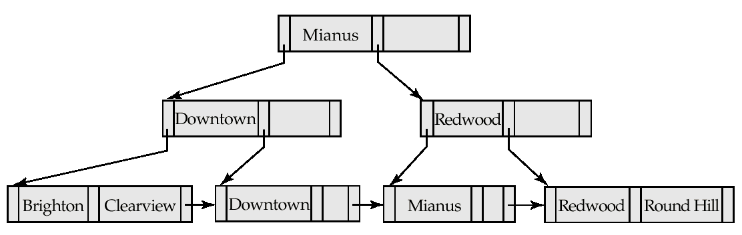
Example of B⁺-tree Deletion (Cont.)
Deletion of “Perryridge”
Parent of leaf containing Perryridge became underfull, and borrowed a pointer from its left sibling
Search-key value in the parent’s parent changes as a result

Slide 46
B⁺-Tree File Organization
Index file degradation (退化) problem is solved by using B⁺-Tree indices. Data file degradation problem is solved by using B⁺-Tree File Organization (B⁺树文件组织）
The leaf nodes in a B⁺-tree file organization store records, instead of pointers
Since records are larger than pointers, the maximum number of records that can be stored in a leaf node is less than the number of pointers in a non-leaf node
Leaf nodes are still required to be half full
Insertion and deletion are handled in the same way as the insertion and deletion of entries in a B⁺-tree index

Slide 47
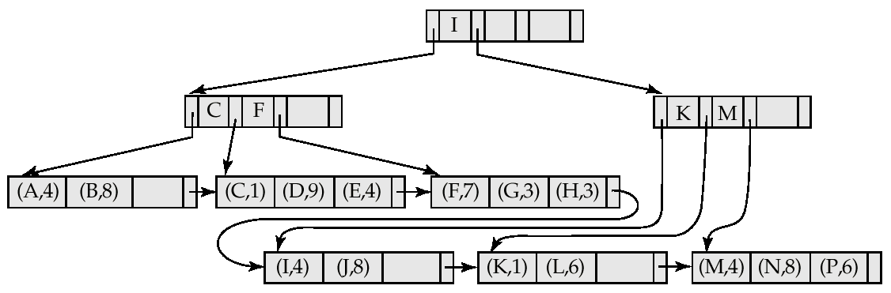
B⁺-Tree File Organization (Cont.)
Good space utilization is important since records use more space than pointers.
To improve space utilization, involve more sibling nodes in redistribution
Involving 2 siblings or more in redistribution to avoid split / merge where possible

Slide 48
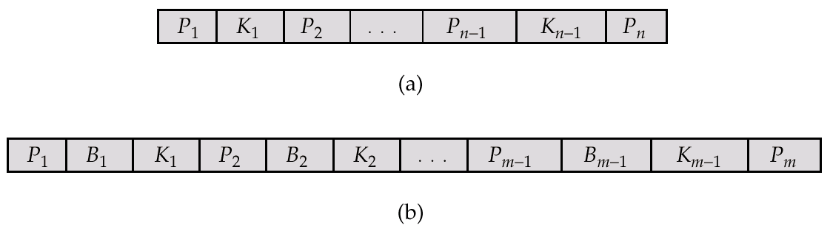
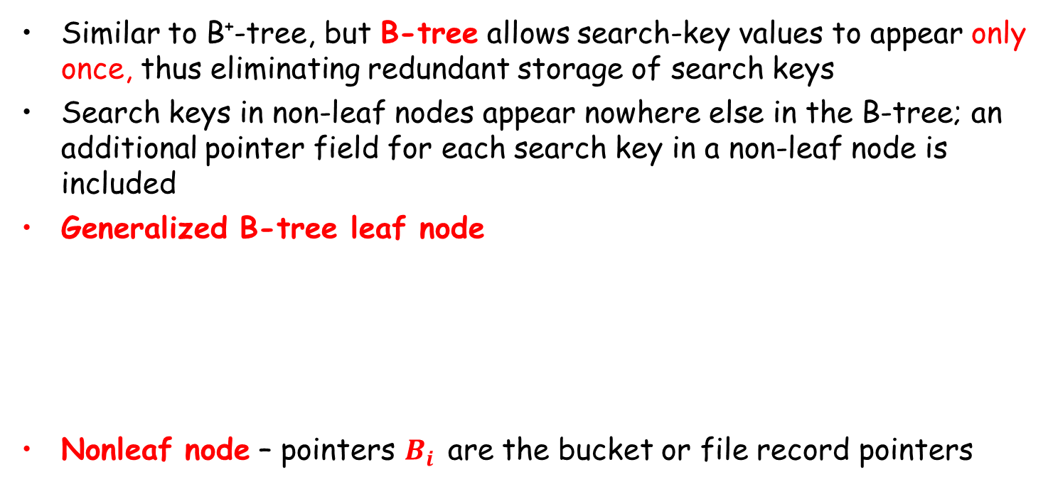
B-Tree Index Files
Similar to B⁺-tree, but B-tree allows search-key values to appear only once, thus eliminating redundant storage of search keys
Search keys in non-leaf nodes appear nowhere else in the B-tree; an additional pointer field for each search key in a non-leaf node is included
Generalized B-tree leaf node
Nonleaf node – pointers $B_{i}$ are the bucket or file record pointers
Leaf node
Non-leaf node

Slide 49
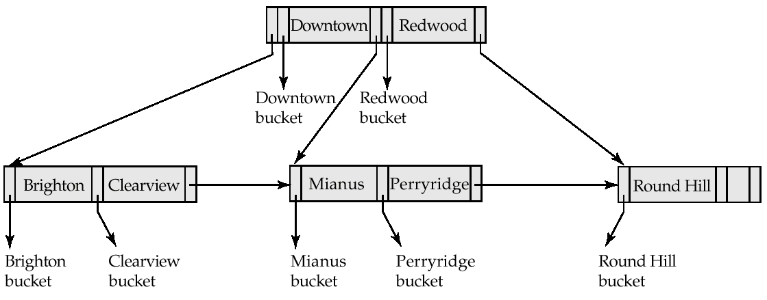
B-Tree Index File
B-tree (above) and B⁺-tree (below) on same data

Slide 50
B-Tree Index Files (Cont.)
Advantages of B-Tree indices
Use less tree nodes than B⁺-Tree
Sometimes possible to find search-key value before reaching leaf node.
Disadvantages of B-Tree indices
Only a small fraction of all search-key values are found early
Non-leaf nodes are larger, so fan-out is reduced. Thus B-Trees typically have greater depth than B⁺-Tree
Insertion and deletion are more complicated than in B⁺-Trees
Implementation is harder than B⁺-Trees
Typically, the advantages of B-Trees do not outweigh disadvantages

Slide 51
Outline
Basic Concepts
Ordered Indexing
B⁺-tree & B-tree Indices
☞ Static & Dynamic Hashing
Ordered Indexing vs. Hashing
Index Definition in SQL
Multiple-key Access

Slide 52
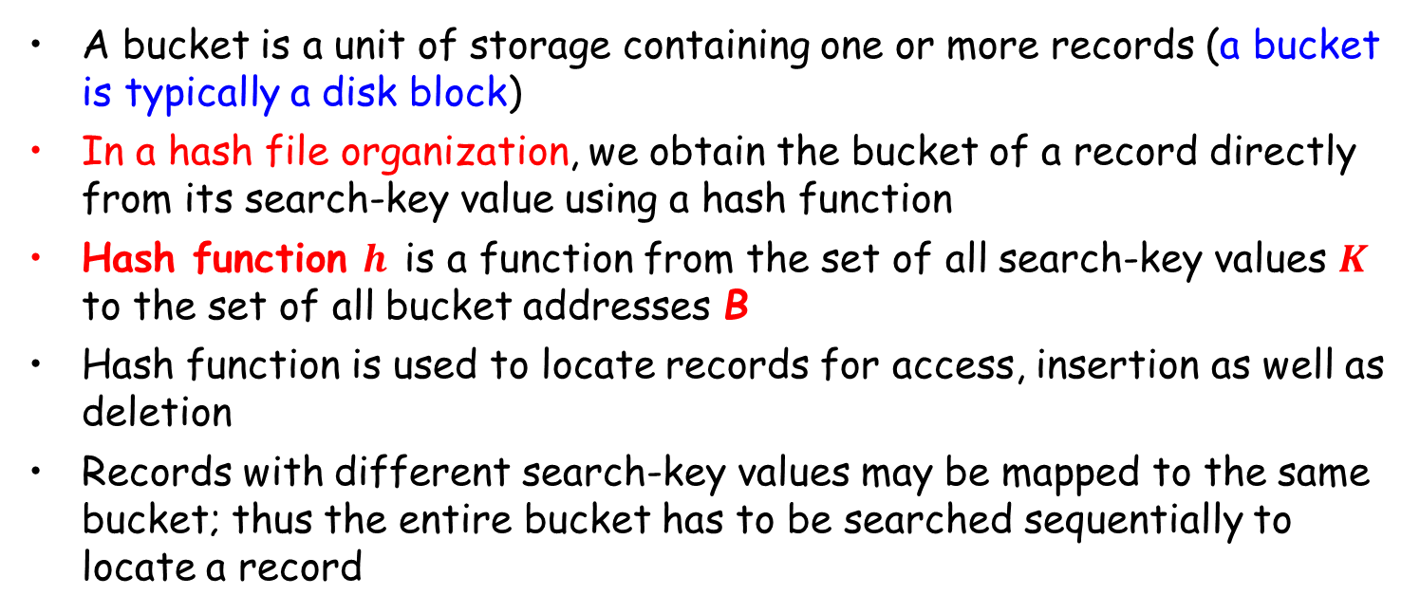
Static Hashing
A bucket is a unit of storage containing one or more records (a bucket is typically a disk block)
In a hash file organization, we obtain the bucket of a record directly from its search-key value using a hash function
Hash function $h$ is a function from the set of all search-key values $K$ to the set of all bucket addresses B
Hash function is used to locate records for access, insertion as well as deletion
Records with different search-key values may be mapped to the same bucket; thus the entire bucket has to be searched sequentially to locate a record

Slide 53
Example of Hash File Organization (Cont.)
Hash file organization of account file, using branch-name as key (See figure in next slide)
There are 10 buckets
The binary representation of the i-th character is assumed to be the integer i
The hash function returns the sum of the binary representations of the characters modulo 10
E.g. h(Perryridge) = 125 mod 10 = 5 h(Round Hill) = 113 mod 10 = 3 h(Brighton) = 93 mod 10 = 3

Slide 54
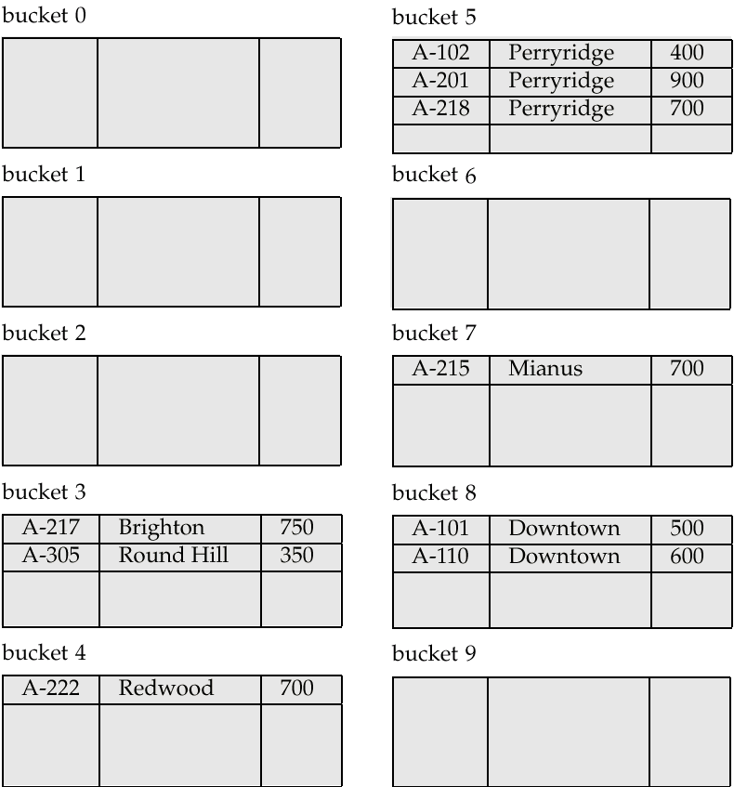
Example of Hash File Organization
Hash file organization of account file, using branch-name as key.
The binary representation of the i-th character is assumed to be the integer i
h(Perryridge) = 125 mod 10 = 5 h(Round Hill) = 113 mod 10 = 3 h(Brighton) = 93 mod 10 = 3

Slide 55
Hash Functions
Worst hash function maps all search-key values to the same bucket
An ideal hash function is uniform, i.e., each bucket is assigned the same number of search-key values from the set of all possible values
Ideal hash function is random, so each bucket will have the same number of records assigned to it irrespective of the actual distribution of search-key values in the file
Typical hash functions perform computation on the internal binary representation of the search-key

Slide 56
Handling of Bucket Overflows
Bucket overflow can occur because of
Insufficient buckets
Skew in distribution of records. This can occur due to two reasons:
multiple records have same search-key value
chosen hash function produces non-uniform distribution of key values
Although the probability of bucket overflow can be reduced, it cannot be eliminated; it is handled by using overflow buckets

Slide 57
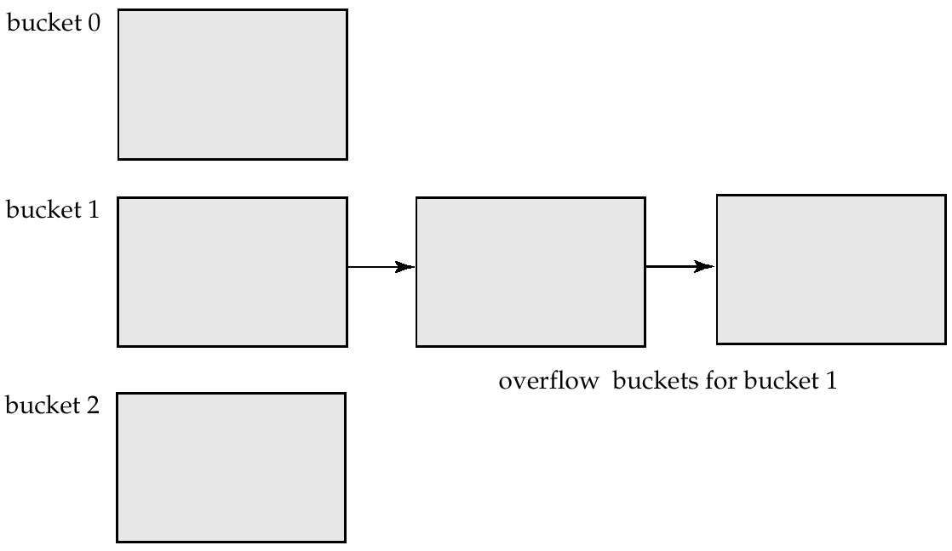
Handling of Bucket Overflows (Cont.)
Overflow chaining – the overflow buckets of a given bucket are chained together in a linked list

Slide 58
Hash Indices
Hashing can be used not only for file organization, but also for index-structure creation
A hash index organizes the search keys, with their associated record pointers, into a hash file structure
Strictly speaking, hash indices are always secondary indices
if the file itself is organized using hashing, a separate primary hash index on it using the same search-key is unnecessary
However, we use the term hash index to refer to both secondary index structures and hash organized files

Slide 59
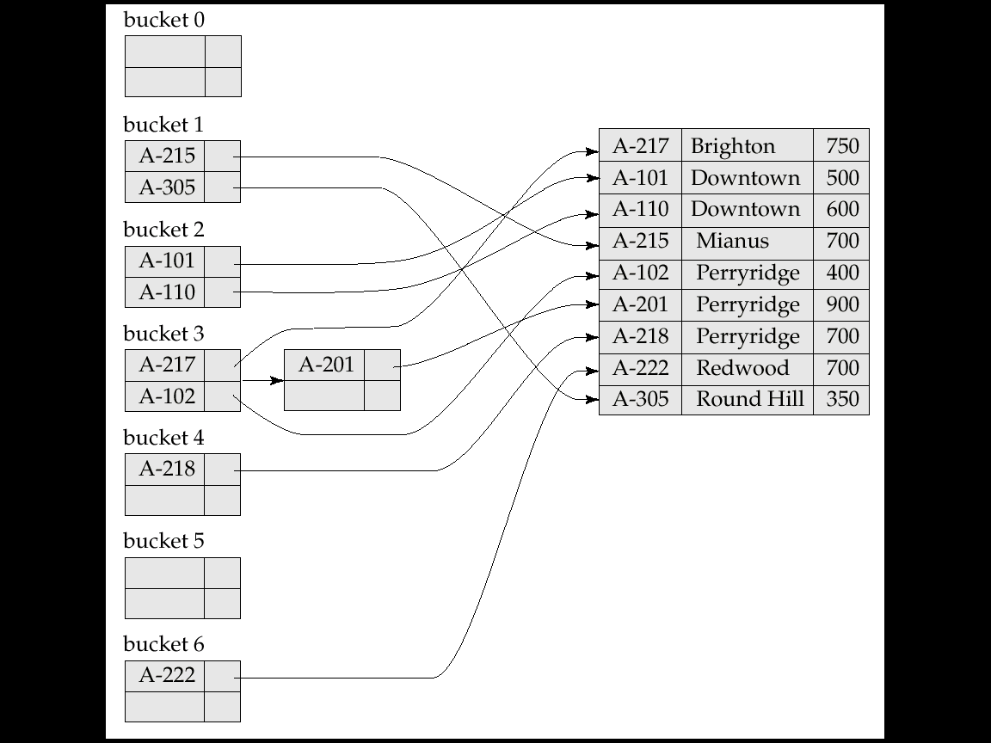
Example of Hash Index
A secondary hash index on the account file, for the search key account_number.
The hash function computes the sum of the digits of the account number modulo 7.
The hash index has 7 buckets, each of size 2. One has a overflow bucket.

Slide 60
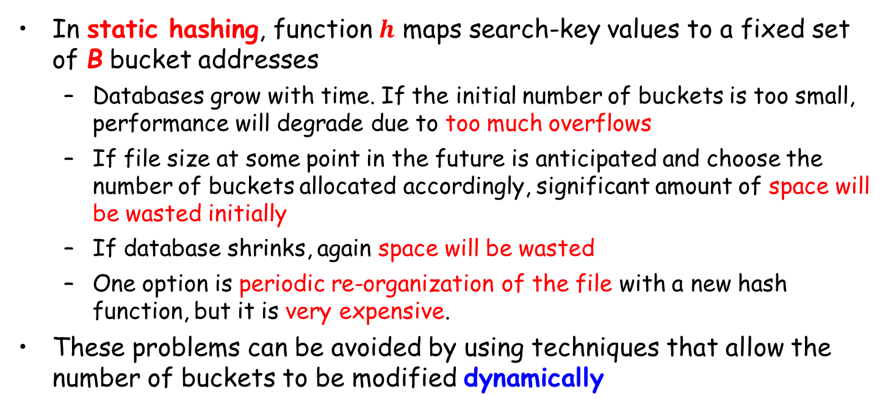
Deficiencies of Static Hashing
In static hashing, function $h$ maps search-key values to a fixed set of B bucket addresses
Databases grow with time. If the initial number of buckets is too small, performance will degrade due to too much overflows
If file size at some point in the future is anticipated and choose the number of buckets allocated accordingly, significant amount of space will be wasted initially
If database shrinks, again space will be wasted
One option is periodic re-organization of the file with a new hash function, but it is very expensive.
These problems can be avoided by using techniques that allow the number of buckets to be modified dynamically

Slide 61
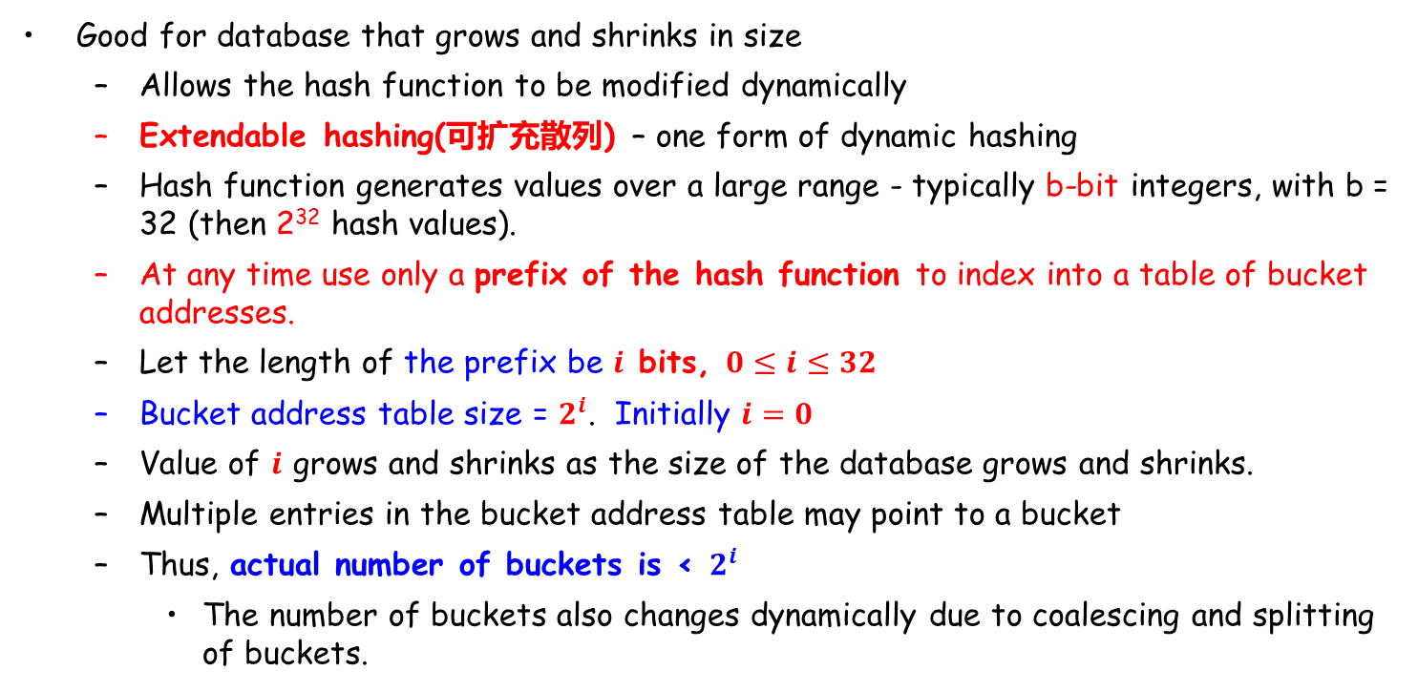
Dynamic Hashing
Good for database that grows and shrinks in size
Allows the hash function to be modified dynamically
Extendable hashing(可扩充散列) – one form of dynamic hashing
Hash function generates values over a large range - typically b-bit integers, with b = 32 (then 2³² hash values).
At any time use only a prefix of the hash function to index into a table of bucket addresses.
Let the length of the prefix be $i$ bits, $0≤i≤32$
Bucket address table size = $2^{i}$. Initially $i=0$
Value of $i$ grows and shrinks as the size of the database grows and shrinks.
Multiple entries in the bucket address table may point to a bucket
Thus, actual number of buckets is < $2^{i}$
The number of buckets also changes dynamically due to coalescing and splitting of buckets.

Slide 62
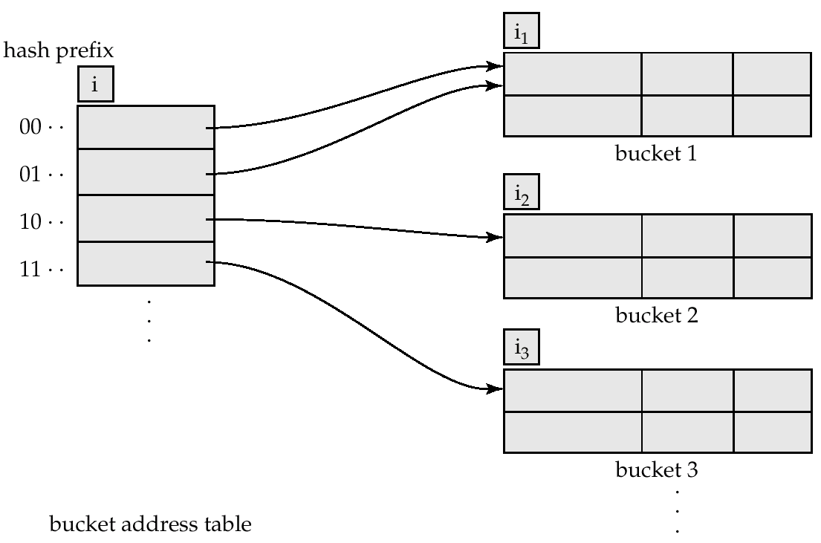
General Extendable Hash Structure

Slide 63
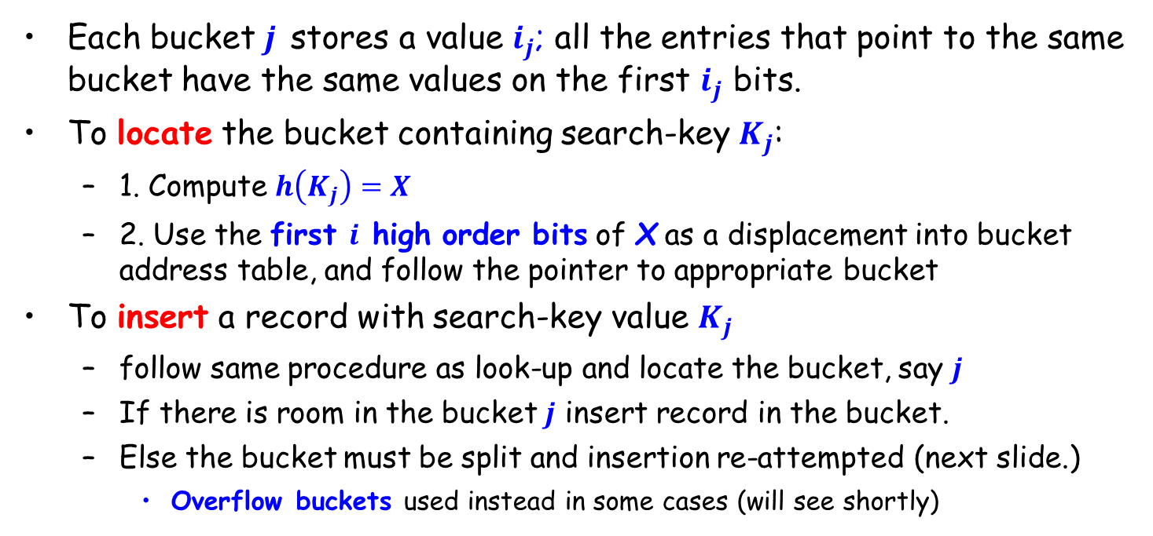
Use of Extendable Hash Structure
Each bucket $j$ stores a value $i_{j}$; all the entries that point to the same bucket have the same values on the first $i_{j}$ bits.
To locate the bucket containing search-key $K_{j}$:
1. Compute $h\left(K_{j}\right)=X$
2. Use the first $i$ high order bits of X as a displacement into bucket address table, and follow the pointer to appropriate bucket
To insert a record with search-key value $K_{j}$
follow same procedure as look-up and locate the bucket, say $j$
If there is room in the bucket $j$ insert record in the bucket.
Else the bucket must be split and insertion re-attempted (next slide.)
Overflow buckets used instead in some cases (will see shortly)

Slide 64
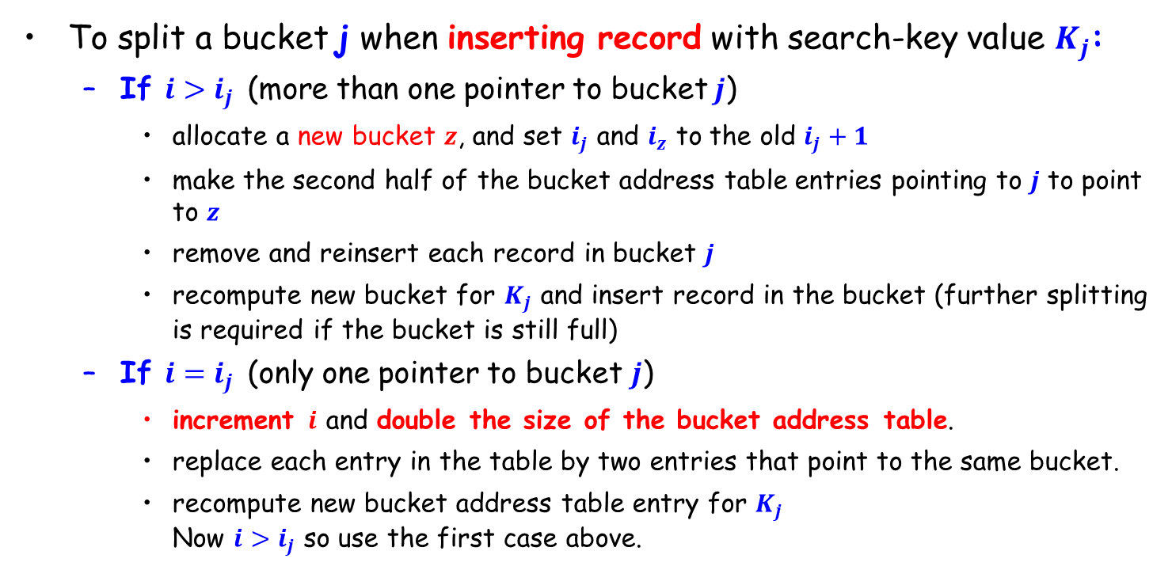
Updates in Extendable Hash Structure
To split a bucket j when inserting record with search-key value $K_{j}$:
If $i>i_{j}$ (more than one pointer to bucket $j$)
allocate a new bucket $z$, and set $i_{j}$ and $i_{z}$ to the old $i_{j}+1$
make the second half of the bucket address table entries pointing to $j$ to point to $z$
remove and reinsert each record in bucket $j$
recompute new bucket for $K_{j}$ and insert record in the bucket (further splitting is required if the bucket is still full)
If $i=i_{j}$ (only one pointer to bucket $j$)
increment $i$ and double the size of the bucket address table.
replace each entry in the table by two entries that point to the same bucket.
recompute new bucket address table entry for $K_{j}$ Now $i>i_{j}$ so use the first case above.

Slide 65
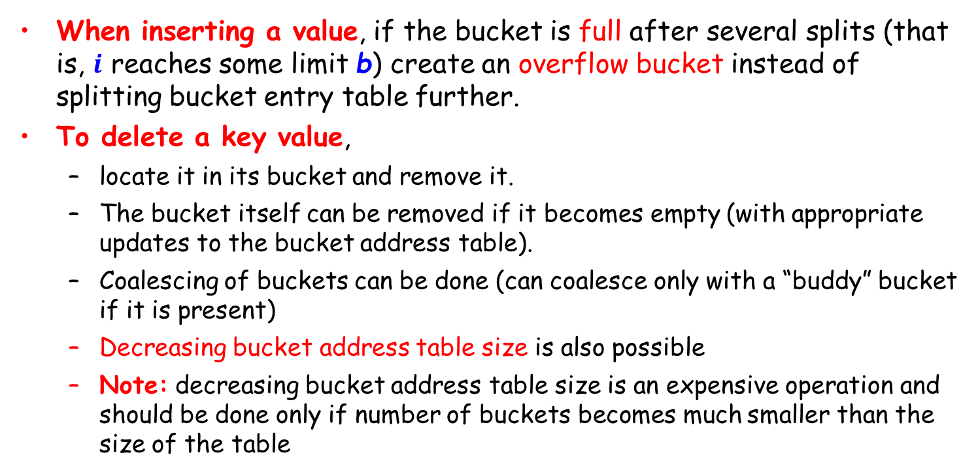
Updates in Extendable Hash Structure (Cont.)
When inserting a value, if the bucket is full after several splits (that is, $i$ reaches some limit b) create an overflow bucket instead of splitting bucket entry table further.
To delete a key value,
locate it in its bucket and remove it.
The bucket itself can be removed if it becomes empty (with appropriate updates to the bucket address table).
Coalescing of buckets can be done (can coalesce only with a “buddy” bucket if it is present)
Decreasing bucket address table size is also possible
Note: decreasing bucket address table size is an expensive operation and should be done only if number of buckets becomes much smaller than the size of the table

Slide 66
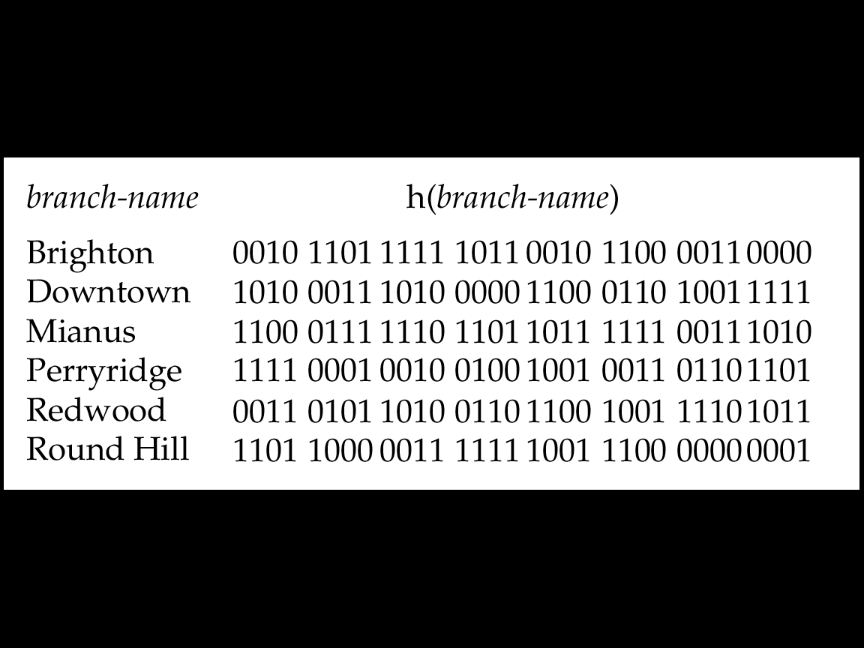
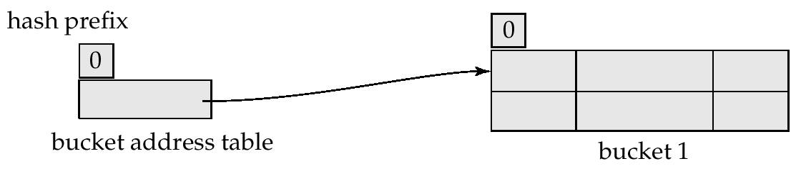
Use of Extendable Hash Structure: Example
Initial Hash structure, bucket size = 2

Slide 67
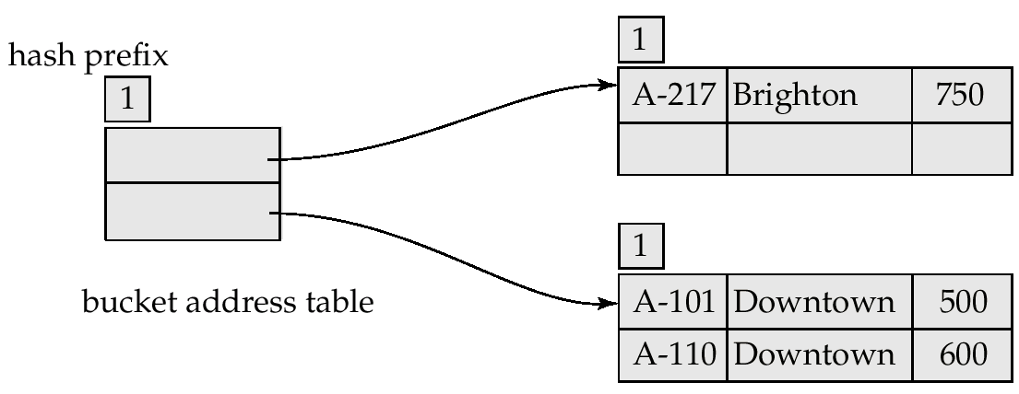
Example (Cont.)
Hash structure after insertion of one Brighton and two Downtown records

Slide 68
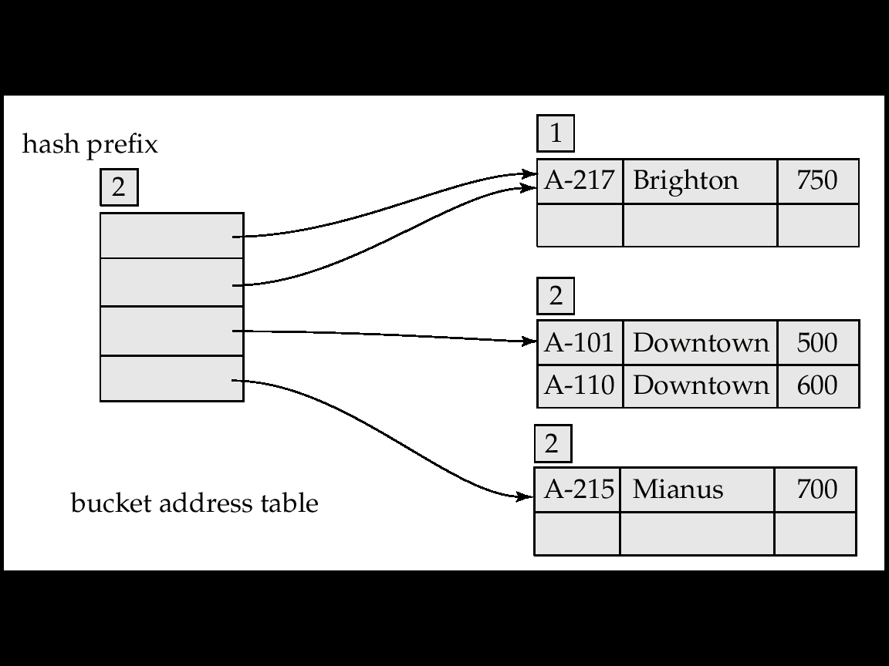
Example (Cont.)
Hash structure after insertion of Mianus record

Slide 69
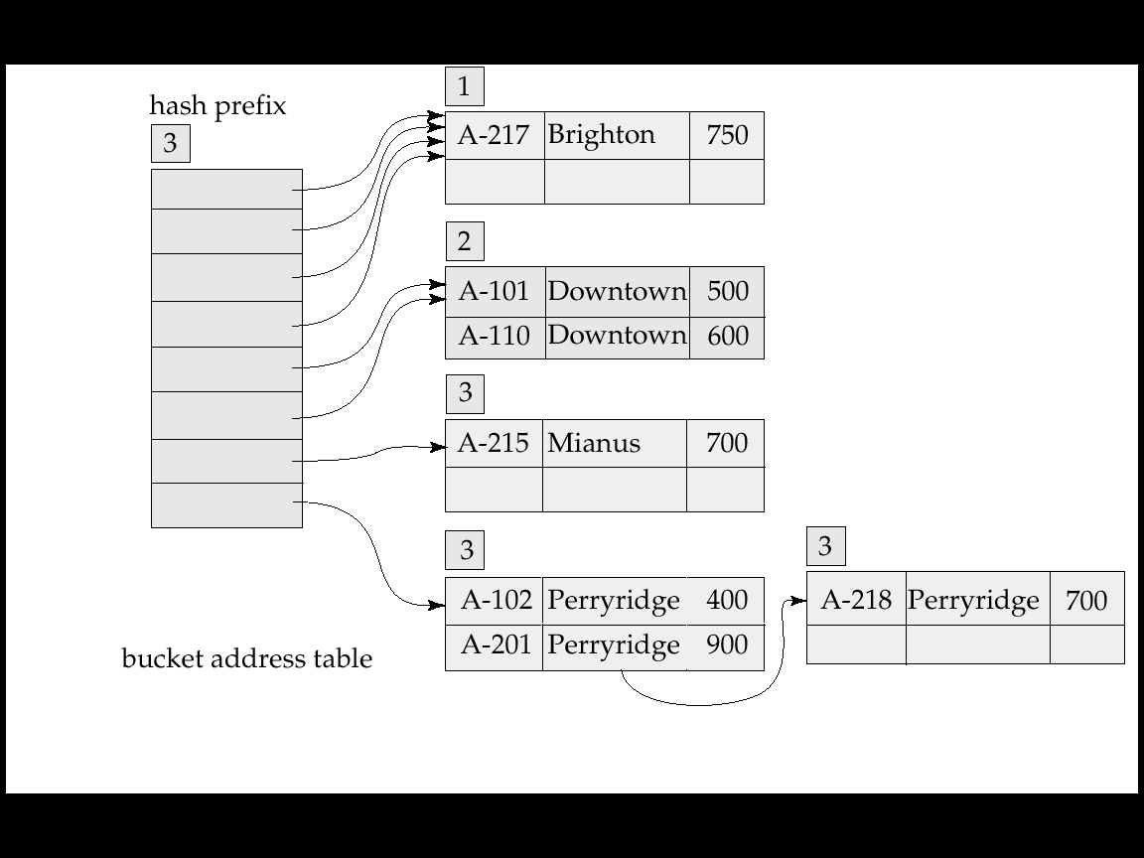
Example (Cont.)
Hash structure after insertion of three Perryridge records

Slide 70
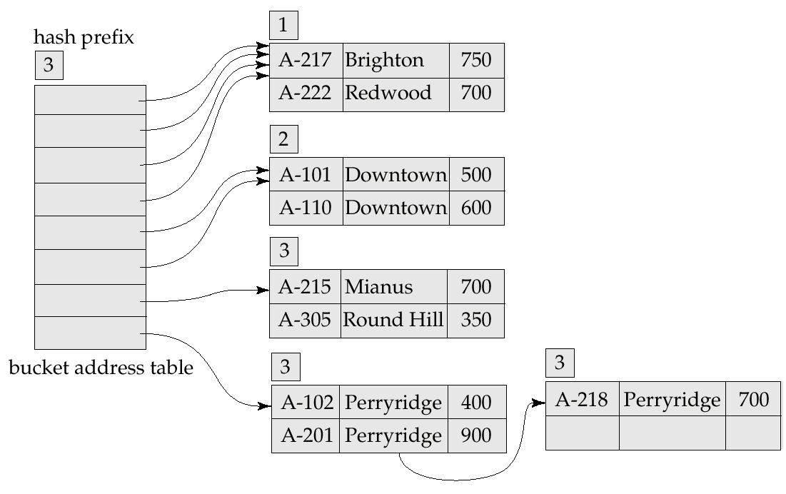
Example (Cont.)
Hash structure after insertion of Redwood and Round Hill records

Slide 71
Extendable Hashing vs. Other Schemes
Benefits of extendable hashing:
Hash performance does not degrade with growth of file
Minimal space overhead
Disadvantages of extendable hashing
Extra level of indirection to find desired record
Bucket address table may itself become very big (larger than memory)
Need a tree structure to locate desired record in the structure !
Changing size of bucket address table is an expensive operation
Linear hashing is an alternative mechanism which avoids these disadvantages at the possible cost of more bucket overflows

Slide 72
Outline
Basic Concepts
Ordered Indexing
B⁺-tree & B-tree Indices
Static & Dynamic Hashing
☞ Ordered Indexing vs. Hashing
Index Definition in SQL
Multiple-key Access

Slide 73
Ordered Indexing vs. Hashing
Issues for file organizing and indexing
Cost of periodic re-organization
Frequency of insertions and deletions
Whether optimizing average access time at the expense of worst-case access time
Expected type of queries
Hashing is generally better at retrieving records having a specified value of the key
If range queries are common, ordered indices are preferred

Slide 74
Outline
Basic Concepts
Ordered Indexing
B⁺-tree & B-tree Indices
Static & Dynamic Hashing
Ordered Indexing vs. Hashing
☞ Index Definition in SQL
Multiple-key Access

Slide 75
Index Definition in SQL
Create an index
create [UNIQUE] index <index-name> on <relation-name> (<attribute-list>)
E.g., create index b_index on branch(branch_name)
Use create unique index to indirectly specify and enforce the condition that the search key is a candidate key
Not really required if SQL unique integrity constraint is supported
Drop an index
drop index <index-name>

Slide 76
Outline
Basic Concepts
Ordered Indexing
B⁺-tree & B-tree Indices
Static & Dynamic Hashing
Ordered Indexing vs. Hashing
Index Definition in SQL
☞ Multiple-key Access

Slide 77
Multiple-Key Access
Use multiple indices for certain types of queries
E.g.,
select account_number
from account
where branch_name = “Perryridge” and balance = 1000
Three possible strategies for processing query using indices on single attributes
Use index on branch_name to find accounts with branch_name = “Perryridge”, test balances of $1000; .
Use index on balance to find accounts with balances of $1000; test branch_name = “Perryridge”.
Use branch_name index to find pointers to all records pertaining to the Perryridge branch. Similarly use index on balance. Take intersection of both sets of pointers obtained

Slide 78
Indices on Multiple Attributes
Suppose we have an index on combined search-key (branch_name, balance)
With the where clause where branch_name = “Perryridge” and balance = 1000 the index on the combined search-key will fetch only records that satisfy both conditions
Can also efficiently handle where branch_name = “Perryridge” and balance < 1000
But cannot efficiently handle where branch-name < “Perryridge” and balance = 1000 May fetch many records that satisfy the first but not the second condition, may lead to many I/Os

Slide 79
Grid Files
Structure used to speed up the processing of general multiple search-key queries involving one or more comparison operators
The grid file has a single grid array and one linear scale for each search-key attribute. The grid array has the number of dimensions equal to number of search-key attributes
Multiple cells of grid array can point to same bucket
To find the bucket for a search-key value, locate the row and column of its cell using the linear scales and follow pointer

Slide 80
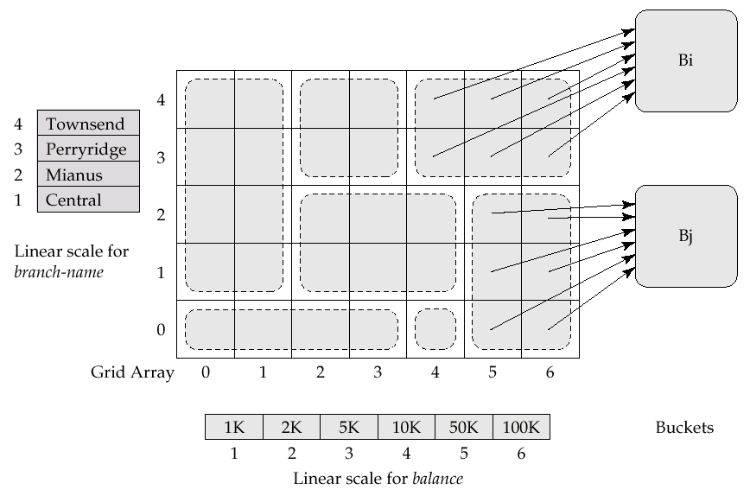
Example Grid File for account

Slide 81
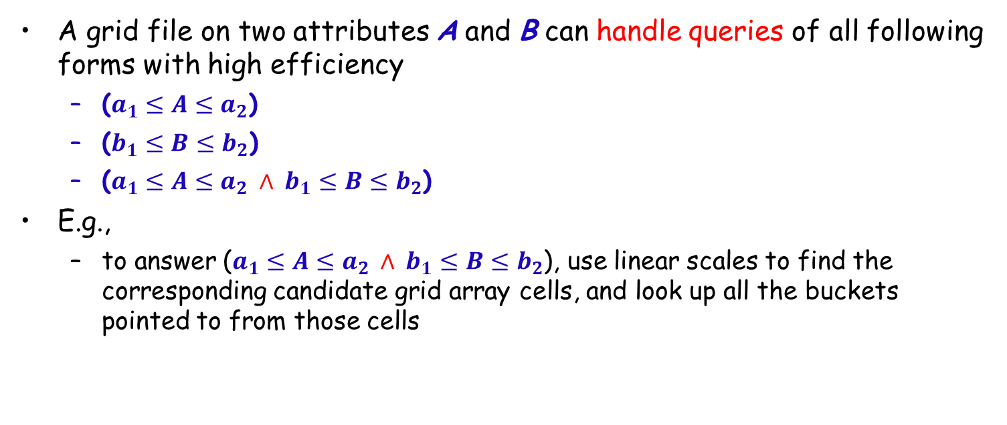
Queries on a Grid File
A grid file on two attributes A and B can handle queries of all following forms with high efficiency
($a_{1}≤A≤a_{2}$)
($b_{1}≤B≤b_{2}$)
($a_{1}≤A≤a_{2}$ $∧$ $b_{1}≤B≤b_{2}$)
E.g.,
to answer ($a_{1}≤A≤a_{2}$ $∧$ $b_{1}≤B≤b_{2}$), use linear scales to find the corresponding candidate grid array cells, and look up all the buckets pointed to from those cells

Slide 82
Grid Files (Cont.)
During insertion, if a bucket becomes full, new bucket can be created if more than one cell points to it
Idea similar to extendable hashing, but on multiple dimensions
If only one cell points to it, either an overflow bucket must be created or the grid size must be increased
Linear scales must be chosen to uniformly distribute records across cells.
Otherwise there will be too many overflow buckets.
Periodic re-organization to increase grid size will help
But reorganization can be very expensive.
Space overhead of grid array can be high.

Slide 83
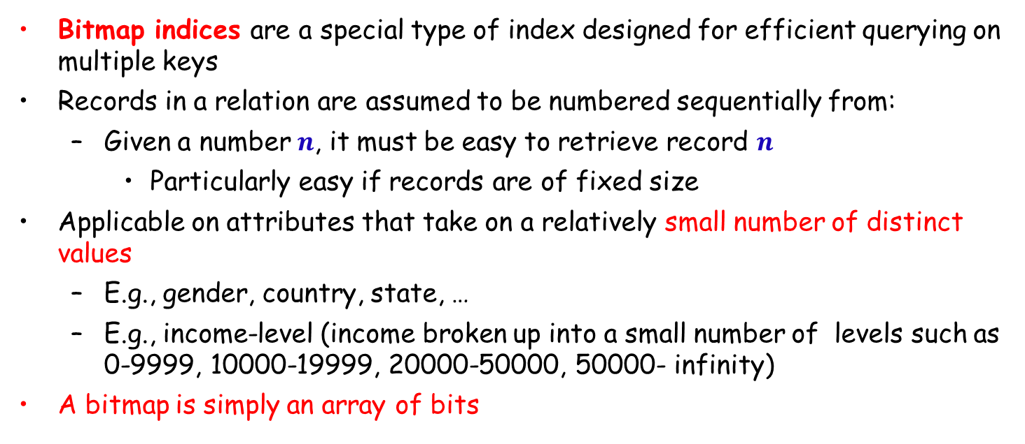
Bitmap Indices
Bitmap indices are a special type of index designed for efficient querying on multiple keys
Records in a relation are assumed to be numbered sequentially from:
Given a number $n$, it must be easy to retrieve record $n$
Particularly easy if records are of fixed size
Applicable on attributes that take on a relatively small number of distinct values
E.g., gender, country, state, …
E.g., income-level (income broken up into a small number of levels such as 0-9999, 10000-19999, 20000-50000, 50000- infinity)
A bitmap is simply an array of bits

Slide 84


Bitmap Indices (Cont.)
In its simplest form, a bitmap index on an attribute has a bitmap for each value of the attribute
Bitmap has as many bits as records
In a bitmap for value $v$, the bit for a record is 1 if the record has the value $v$ for the attribute, and is 0 otherwise

Slide 85
Bitmap Indices (Cont.)
Bitmap indices are useful for queries on multiple attributes
not particularly useful for single attribute queries
Queries are answered using bitmap operations
Intersection (and)
Union (or)
Complementation (not)
Each operation takes two bitmaps of the same size and applies the operation on corresponding bits to get the result bitmap
E.g., 100110 AND 110011 = 100010
100110 OR 110011 = 110111 NOT 100110 = 011001
Males with income level L1: 10010 AND 10100 = 10000
Can then retrieve required tuples
Counting number of matching tuples is even faster

Slide 86
Bitmap Indices (Cont.)
Bitmap indices generally very small compared with relation size
E.g. if record is 100 bytes, space for a single bitmap is 1/800 of space used by relation.
If number of distinct attribute values is 8, bitmap is only 1% of relation size
Deletion needs to be handled properly
Existence bitmap to note if there is a valid record at a record location
Needed for complementation
not(A=v): (NOT bitmap-A-v) AND ExistenceBitmap
Should keep bitmaps for all values, even null value
To correctly handle SQL null semantics for NOT(A=v):
intersect above result with (NOT bitmap-A-Null)

Slide 87
Assignments-Quiz
Q1: Construct a B⁺-tree from an empty tree. Each node can hold four pointers
The sequential values to be inserted are: 10, 7, 12, 5, 9, 15, 30, 23, 17, 26
Then delete 9, 10, 15, respectively
Please give the B⁺ trees after each insertion and each deletion
Q2: Compare B⁺-tree and B-tree and describe their difference

Slide 88
补充学习（索引相关）
商用数据库
Oracle索引结构：B树索引，位图索引
《Oracle索引技术》,人民邮电出版社
IBM DB2索引结构：B⁺树
Microsoft SQL Server索引结构：B树
开源数据库
MySQL索引：B-Tree(B+Tree)、Hash索引
Postgre SQL, MySQL, Ingres r3, MaxDB, Firebird (InterBase), MongoDB, SQLite, CUBRID, Cayley(Graph)
NoSQL数据库
HBase, Cassandra, MongoDB, Redis
OceanBase, openGauss, 人大金仓, X-DB, 达梦 ……

Slide 89
Research framework
LBS
Smart city
Navigation
Applications
Geo-tagging of reality
Location-based advertisement
Retrieval
Standard queries
Advanced queries
Indexing
Spatial indexing
Textual indexing
Hybrid indexing
Data fusion
Geo-coding
Data processing
Objects extraction
Data cleaning
Spatio-textual data
Spatio-textual data
Spatio-textual data
Spatio-textual data
Notes:
The focus in this framework are the indexing structures and query processing algorithms (retrieval).

Slide 90


Spatio-textual objects
𝒐=(𝒍,𝒅)
𝑜.𝑙: spatial location, 𝑜.𝑑: text description
POI: shop, bank, restaurant, museum, school, hospital, etc.
Geo-tagged web contents: news, images, videos, comments, micro-blogs
Notes:
We use spatio-textual objects to model data containing both spatial and textual content.
Each spatio-textual object consists of two parts:
Spatial location
Text description
Examples: The spatio-textual objects could be POIs and geo-tagged web contents.

Slide 91
Spatio-textual indices
Spatial indices
Textual indices
Grid
Inverted file
R-tree
Signature file
SFC
Space filling curve
Bitmap
…
…
Notes:
Almost all solutions to spatial keywords queries are based on some hybrid indices that combine spatial indices and textual indices.

Slide 92

Spatial index: Grid index
Partition
Tree structure
Notes:
Grid is an up-to-down spatial index that iteratively partitions the whole data space into small grids.

Slide 93
Spatial index: R-tree
R1
R2
R3
R4
o5
o5
o6
o7
o1
o1
o8
o6
o7
o2
o2
o3
o4
o9
o3
o4
o8
o9
o9
R1
o2
R3
o5
R2
o3
o1
o6
o4
o7
o8
R4
Notes:
R-tree cluster spatial points according to their spatial proximity and organize all data points in a tree structure.
R-tree has a big family. Its variants include R*-tree, R+-tree, …

Slide 94
Spatial index: R-tree
R5
R5
R6
R6
R1
R1
R2
R2
R3
R3
R4
R4
o1
o2
o3
o4
o8
o5
o9
o6
o7
o9
R5
R1
o2
R3
o5
R2
o3
o1
o6
o4
o7
o8
R4
R6

Slide 95


Spatial index: space filling curve (SFC)
Z-curve
Hilbert curve
Notes:
SFC is used to transform multiple dimensional coordinates to one dimension.

Slide 96
Textual index: inverted index
shop, shoes
shop, shoes
A
cinema, movie
E
B
F
restaurant, sushi
Spatio-textual objects
shop, bags
D
middle, school
G
C
H
cinema, movie
restaurant, dumplings
Keywords | Spatial-textual objects
shop | A, E, G
shoes | A, E
cinema | B, H
movie | B, H
restaurant | C, F
… | …
Inverted Index
Notes:
Inverted index lists for each keyword those objects that contain it.

Slide 97

Textual index: bitmap
 | $$k_{1}$$ | $$k_{2}$$ | $$k_{3}$$ | $$k_{4}$$ | $$k_{5}$$
$$k_{1}k_{2}k_{3}$$ | 1 | 1 | 1 | 0 | 0
$$k_{2}k_{4}k_{5}$$ | 0 | 1 | 0 | 1 | 1
$$k_{2}k_{4}$$ | 0 | 1 | 0 | 1 | 0
$$k_{1}k_{2}k_{4}k_{5}$$ | 1 | 1 | 0 | 1 | 1
$$k_{4}k_{5}$$ | 0 | 0 | 0 | 1 | 1
…

Slide 98

Textual index: signature file
Terms/documents | Signature
$$k_{1}$$ | sig($k_{1}$)=0000000001
$$k_{2}$$ | sig($k_{2}$)=0000000010
$$k_{3}$$ | sig($k_{3}$)=1000000011
$$k_{1}k_{2}$$ | sig($k_{1}k_{2}$)=sig($k_{1}$) $∨$ sig($k_{2}$)=0000000011
$$k_{2}k_{3}$$ | sig($k_{2}k_{3}$)=sig($k_{2}$) $∨$ sig($k_{3}$)=1000000011
…

Slide 99

ST index& TS index
Grid index + Inverted file
ST: spatial textual index (grid index first)
TS: textual spatial index (inverted file first)
Notes:
S. Vaid, C. B. Jones, H. Joho, and M. Sanderson. Spatio-textual indexing for geographical search on the web. In SSTD, pages 218–235, 2005
ST: Build a grid index first, then build an inverted index for each grid
TS: Build a inverted index first, then build a grid index for each keyword.

Slide 100


R*-tree-IF and IF-R*-tree
R*-tree + Inverted file
R*-tree: a variant of R-tree
R*-Tree-IF
IF-R*-Tree
Notes:
Y. Zhou et al. Hybrid index structures for location-based web search. CIKM05.

Slide 101
KR*-tree (Keyword R*-tree)
R*-tree + Inverted file
Each node is virtually augmented with the set of keywords that appear in its subtree.
Nodes are organized into inverted file
Keyword | Tree nodes
Italian | R₁, R₂, R₃, R₄, R₅, R₆
coffee | R₁, R₂, R₄, R₅, R₆
restaurant | R₁, R₂, R₃, R₄, R₅, R₆
Pizza | R₂, R₄, R₅, R₆
Expensive | R₁, R₂, R₅
Notes:
R. Hariharan, B. Hore, C. Li, and S. Mehrotra. Processing spatial-keyword (sk) queries in geographic information retrieval (gir) systems. In SSDBM, page 16, 2007.

Slide 102
SFC-Quad
Inverted file + Filling curve
Inverted file + Hilbert curve: inverted lists are laid out along a Hilbert curve on disk.
Inverted file + Z-curve: the objects in each inverted list are assigned and ordered based on their spatial positions on the Z-curve.
Z-curve
Hilbert curve
Notes:
Y.-Y. Chen, T. Suel, and A. Markowetz. Efficient query processing in geographic web search engines. In SIGMOD, pages 277–288, 2006.
M. Christoforaki, J. He, C. Dimopoulos, A. Markowetz, and T. Suel. Text vs. space: efficient geo-search query processing. In CIKM, pages 423–432, 2011.
SFC-QUAD maintains a Quad-tree in memory so that the Z-curve order could be easily acquired simply by traversing the Quad-tree in a depth-first manner

Slide 103

IR²-tree
Signature + R-tree
Notes:
I. D. Felipe, V. Hristidis, and N. Rishe. Keyword search on spatial databases. In ICDE, pages 656–665, 2008.
（1）Integrates signature file into each node of the R-tree.
（2）The signature file, in the form of bitmap, is stored for each node of the IR²-tree. The signature file of a node is the union of all signatures of its entries.

Slide 104

SKI (Spatial-Keyword Indexing)
Bitmap + R-tree
Notes:
A. Cary, O. Wolfson, and N. Rishe. Efficient and scalable method for processing top-k spatial boolean queries. In SSDBM, pages 87–95, 2010.
(1) The parent node of a leaf node is called a super node.
(2) Each non-leaf node is augmented with a range of the ids of the super nodes under the non-leaf node.
(3) Each super node is associated with a bitmap version of inverted file.

Slide 105
WIR-tree
R-tree + inverted bitmaps
Variant of IR-tree
Idea
Consider the word frequency
Recursively partition objects by keyword frequency
Notes:
D. Wu, M. L. Yiu, G. Cong, and C. S. Jensen. Joint top-k spatial keyword query processing. IEEE TKDE, 24(10): 1889–1903, 2012.
(1) Aims at partitioning objects into multiple groups such that each group shares as few keywords as possible.
(2) Objects are recursively partitioned by keywords in the order of frequency.

Slide 106
IR-tree
Augment each node of R-tree with a summary of the text content of the objects in the sub-tree
Inverted file
Object descriptions
a: (R3, 4), (R4, 1)
b: (R4, 4)
c: (R3, 4), (R4, 4)
d: (R4, 1)
a
b
c
d
o5
4
0
4
0
o6
0
4
3
0
o7
1
1
4
1
o9
3
0
3
0
R5
R6
R3
R4
o5
o9
o6
o7
Inverted file
Inverted file
a: (o5, 4), (o9, 3)
c: (o5, 4), (o9, 3)
a: (o7, 1)
b: (o6, 4), (o7, 1)
c: (o6, 3), (o7, 4)
d: (o7, 1)
Notes:
[1] G. Cong, C. S. Jensen, and D. Wu. Efficient retrieval of the top-k most relevant spatial web objects. PVLDB, 2(1):337–348, 2009.
[2] D. Wu, G. Cong, and C. S. Jensen. A framework for efficient spatial web object retrieval. VLDBJ, 21(6):797–822, 2012.
[3] Z. Li, K. C. K. Lee, B. Zheng, W.-C. Lee, D. L. Lee, and X. Wang. IR-tree: An efficient index for geographic document search. IEEE TKDE, 23(4):585–599, 2011

Slide 107

S2I (spatial inverted index)
Skewed distribution of keywords
S2I: R-tree + inverted file
Build inverted index first
Build term frequency-aware spatial index
Frequent keywords: aggregated R-trees (aR-trees)
Less frequent keywords: blocks
Frequency
Keywords
Notes:
J. B. Rocha-Junior, O. Gkorgkas, S. Jonassen, and K. Nørvag. Efficient processing of top-k spatial keyword queries. In SSTD, pages 205–222, 2011.
(1) The aR-tree permits accessing the objects in decreasing order of term relevance
(2) The blocks permits storing the less frequent terms efficiently

Slide 108
SKQs in Euclidean space
Standard SKQs
Boolean range query (BRQ)
ST, TS
R*-Tree-IF, IF-R*-tree
KR*-Tree
SKIF
Boolean kNN query (BkQ)
IR2-tree
SKI
WIR-tree
Top-k query (TkQ)
IR-tree
S2I
Advanced SKQs
m-CK query
Reverse query
Moving query
Group query
Direction-aware query
Region of interest query
Why-not query
Similarity join query
…

Slide 109
Indices for SKQ in Euclidean space
Index | Spatial index | Textual Index | Combination | BkQ | TkQ | BRQ
ST | Grid | IF | Spatial-first |  |  | √
TS | Grid | IF | Text-first |  |  | √
IF-R*-Tree | R*-Tree | IF | Text-first | ∆ |  | √
R*-Tree-IF | R*-Tree | IF | Spatial-first |  | ∆ | √
SF2I | SFC | IF | Spatial-first |  |  | √
KR*-Tree | R*-Tree | IF | Tightly combined | ∆ |  | √
IR²-Tree | R-Tree | Bitmap | Tightly combined | √ |  | ∆
IR-Tree | R-Tree | IF | Tightly combined | ∆ | √ | ∆
SKIF | Grid | IF | Tightly combined |  |  | √
SKI | R-Tree | Bitmap | Spatial-first | √
S2I | R-Tree | IF | Text-first | ∆ | √ | ∆
WIR-Tree | R-Tree | Inv. Bitmap | Tightly combined | √ |  | ∆
SFC-QUAD | SFC | IF | Tightly combined |  |  | √

Slide 110
Summary
☞ Basic Concepts
☞ Ordered Indexing
☞ B⁺-tree & B-tree Indices
Static & Dynamic Hashing
Ordered Indexing vs. Hashing
Index Definition in SQL
Multiple-key Access

Slide 111
End of Lecture 14

